Slide 2

This deck was created by the Zenon.Network community.
Some of the concepts presented in these slides are interpretations by the community and are not yet conclusively defined or implemented, and are subject to change pending design and development decisions.
For transparency, slides containing interpretative, undefined, or unimplemented concepts are marked with Ea-T, the fat alien.

Slide 3
>contents
>zenon in a nutshell 5
>core principles 6
>building on Bitcoin 7
>dual coin economy – znn qsr zts 8-10
>network participants 11
>plasma, the feeless fuel 12
>breaking the oligarchy of PoS networks 13
>znn genesis distribution & xStakes 15-16
>dual ledger consensus 17
>embedded smart contracts 18
>ZIPs - zenon improvement proposals 19
>roadmap and milestones 20
>alphanet emissions 21-22
>znn & qsr alphanet supply 23
>digital gold notes 25
>bitcoin pow recycling 26
>layered scaling with trustless, feeless sidechains 27
>zBTC - trustless, feeless, instant, privacy-enhancing 28
>accelerator z 30
>funded & to be funded projects 31-32

Slide 4

>zenon network in a nutshell
WHAT?
A hybrid PoW & PoS L1 smart contract network with feeless transactions and a progressive decentralization path modeled by the values and ethos of Bitcoin. While acting as a standalone L1, Zenon will help solve Bitcoin scaling as an L2 enabling a feeless and trustless layer 3 zApp economy that inherits Bitcoin’s PoW security.
WHO?
Zenon is an entirely community-driven project, built since 2018 by anonymous cypherpunk veterans to solve the most fundamental issues of decentralized networks with an unprecedented dual-ledger / dual-coin network architecture.
HOW?!
Unlike corporate web3, Zenon achieves true decentralisation through
An egalitarian, 100% public distribution with a full BTC refund for the initial validator set.
The decoupling of coinbase incentives from governance.
The elimination of transaction fees by tokenizing network bandwidth which is rewarded to those who help secure the network.
Recycling Bitcoin’ PoW for transaction finality, merge mining, and trustless, feeless Bitcoin transactions.

Slide 5
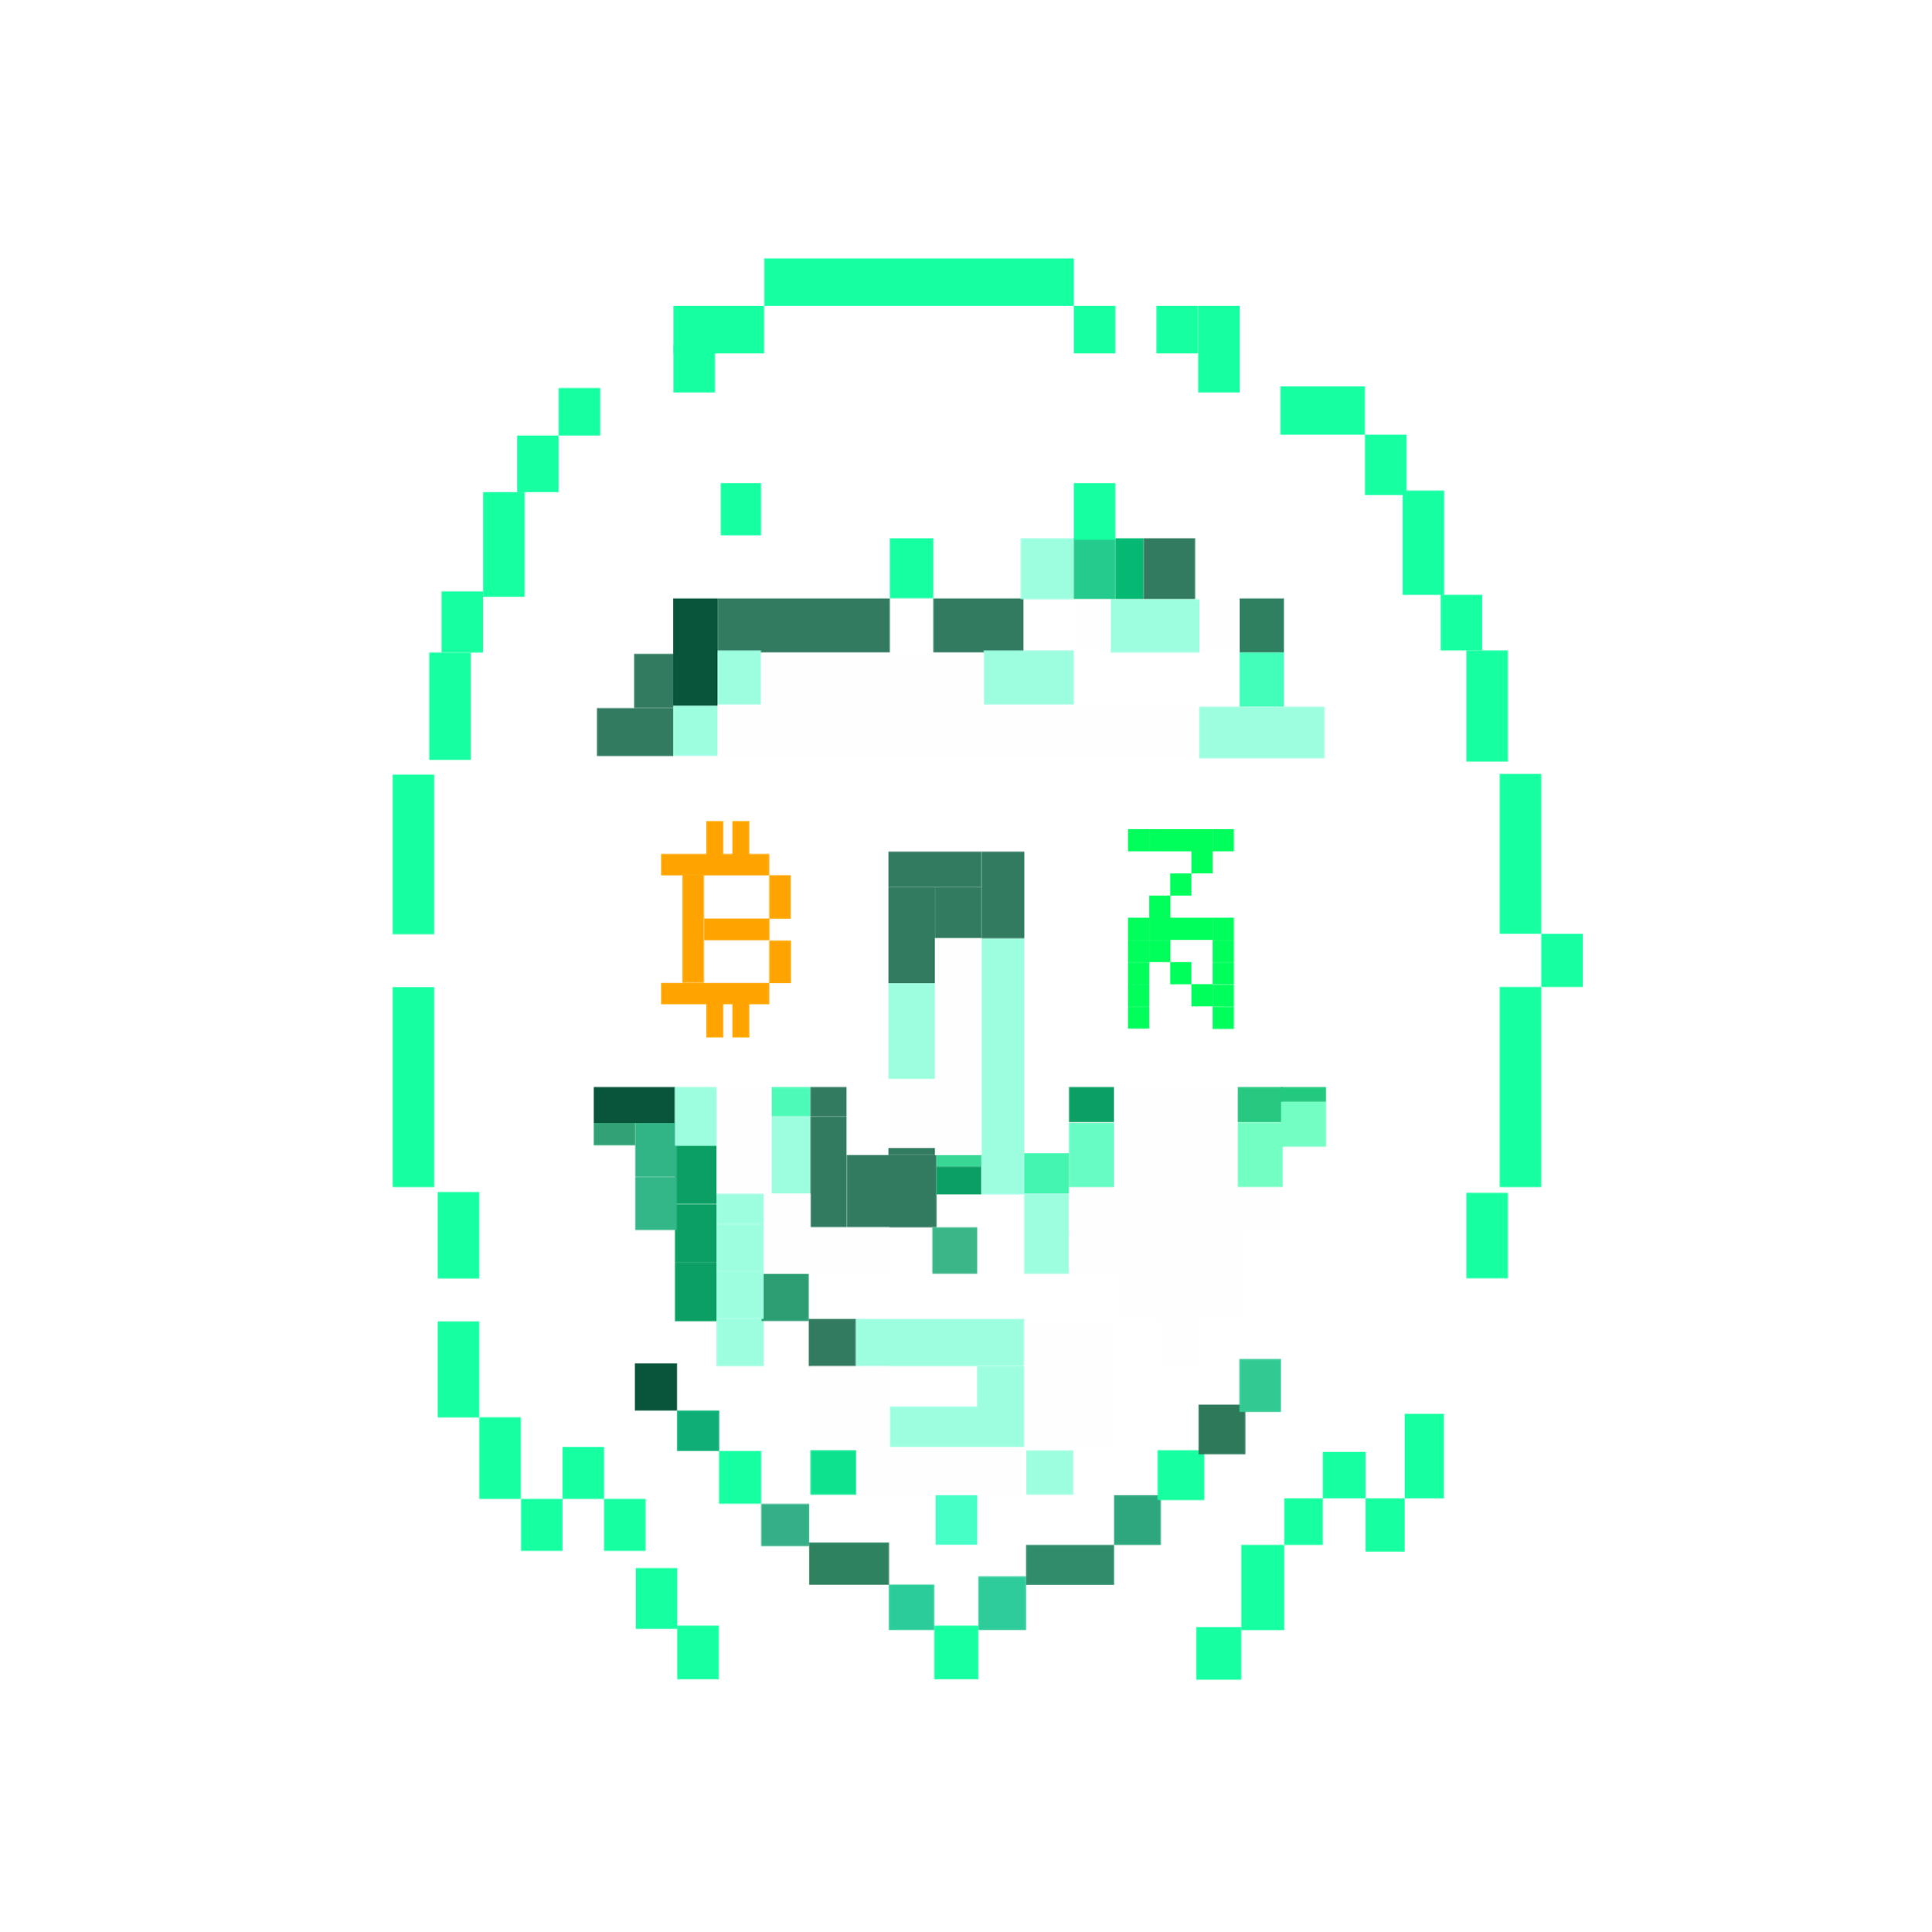

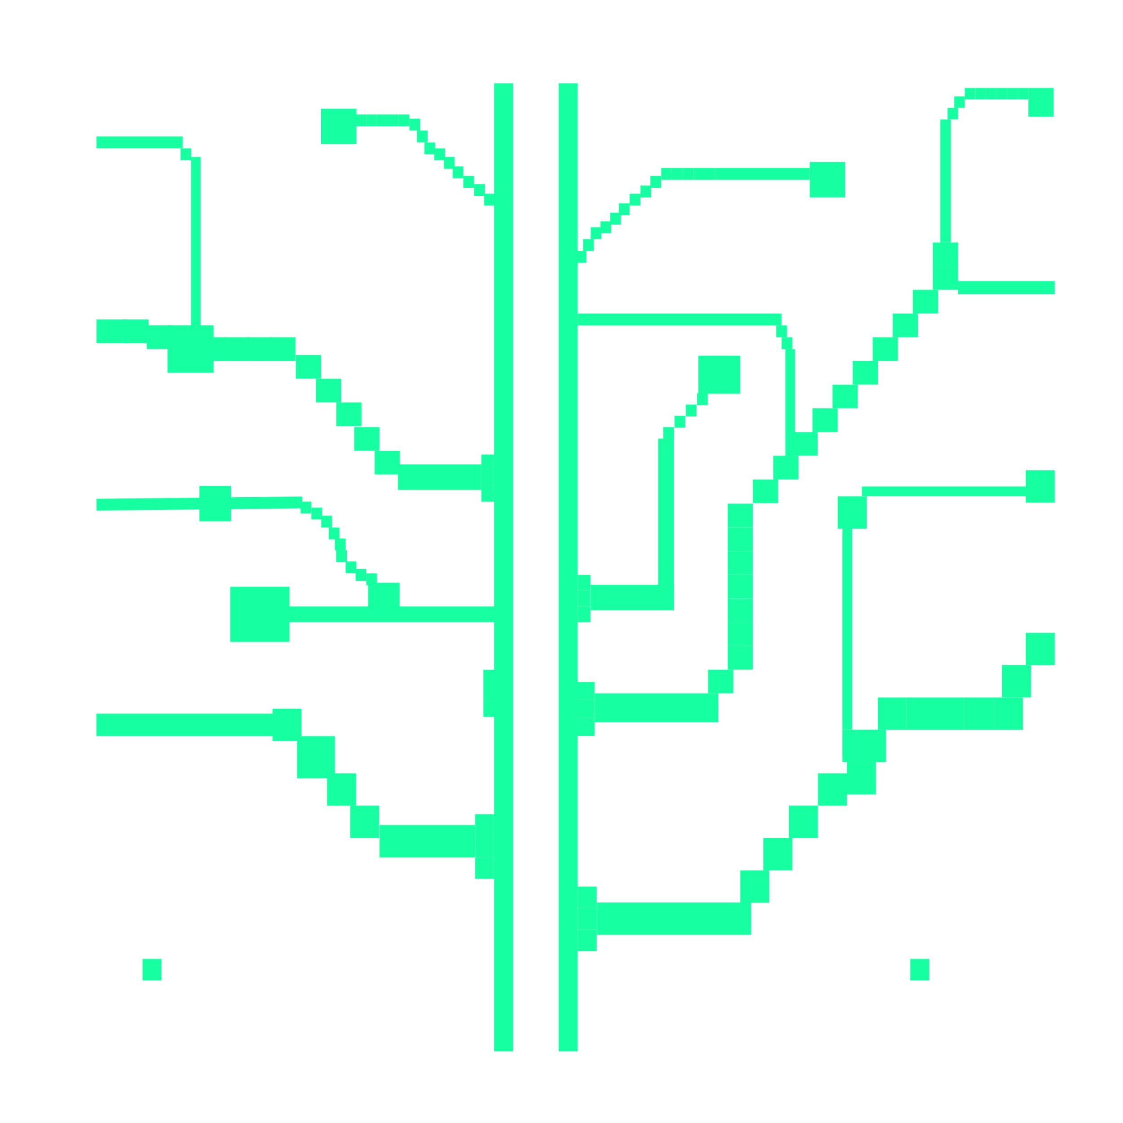
>core principles
CYPHERPUNK ETHOS
PROGRESSIVE DECENTRALIZATION
NETWORK INCENTIVES
With its egalitarian launch, the community’s “acta, non verba” credo, and the founding developers’ devotion to the cypherpunk ethos of open and merit based contributions, Zenon emulates the culture of the early Bitcoin community.
xStakes genesis ensured a pure creation of the initial validator set with no insider advantages. The dual coin economy also ensures the network validators continuously decentralize over time by making them lock up or burn Quasar (QSR).
The network rewards those who help secure it with tokenized, feeless transaction throughput (QSR). It also makes validators choose between maximizing governance power VS financial gain and incentivizes good governance through delegation weight.

Slide 6
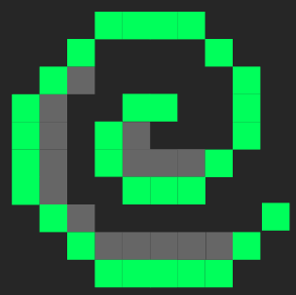

>building on Bitcoin
ZENON NETWORK OF MOMENTUM
DAOs/ DACs
aims at helping solve Bitcoin scaling by leveraging taproot while acting as a standalone smart contract L1 that uses Bitcoin’s PoW as root consensus.
Rather than competing with Bitcoin as the hardest most secure currency, Zenon seeks to complement and add value to the Bitcoin ecosystem as a trustless foundation for nested sidechains across all use case verticals.
Feeless & Trustless Sidechains for
zApps & tokenized asset economies
GameFi
DeFi
Digital ID
IoT
PoS + PoW Zenon Momentums
PoW Links >
PoW Bitcoin Blocks
= Momentum Block

Slide 7
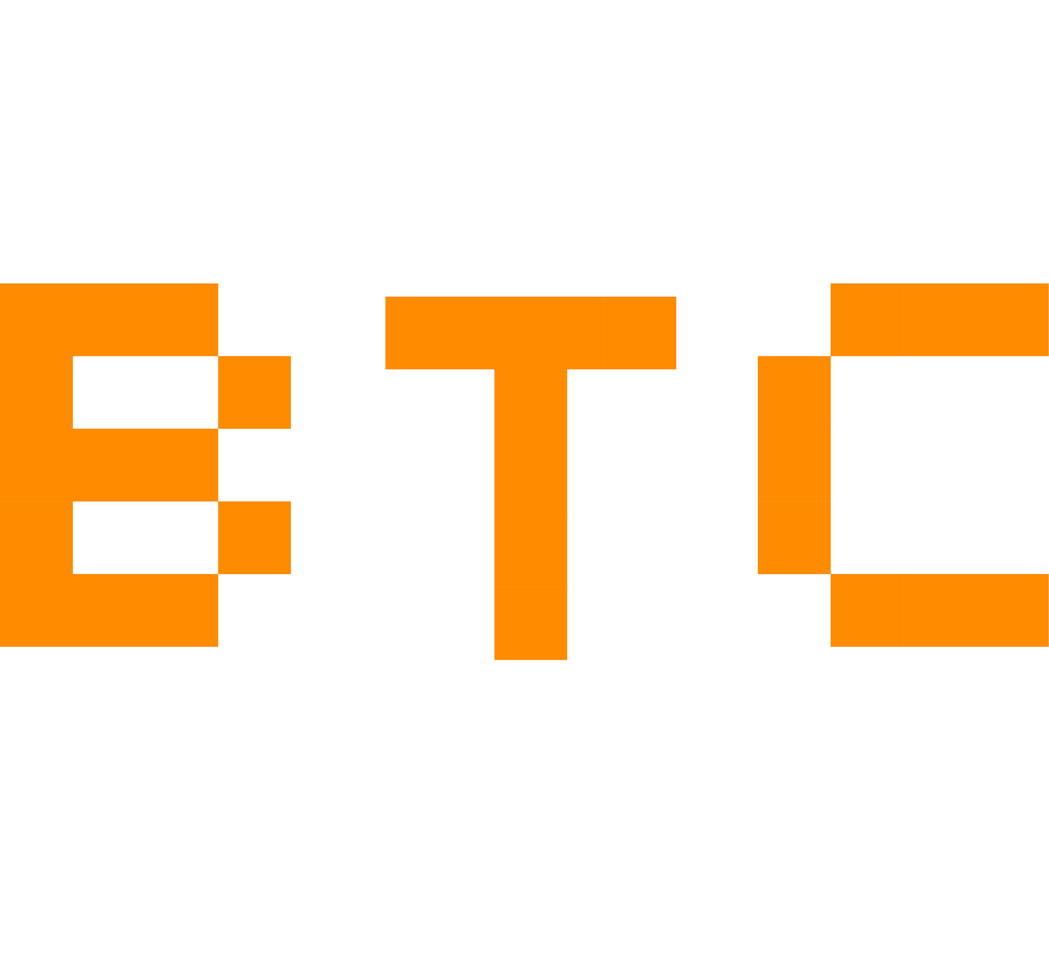
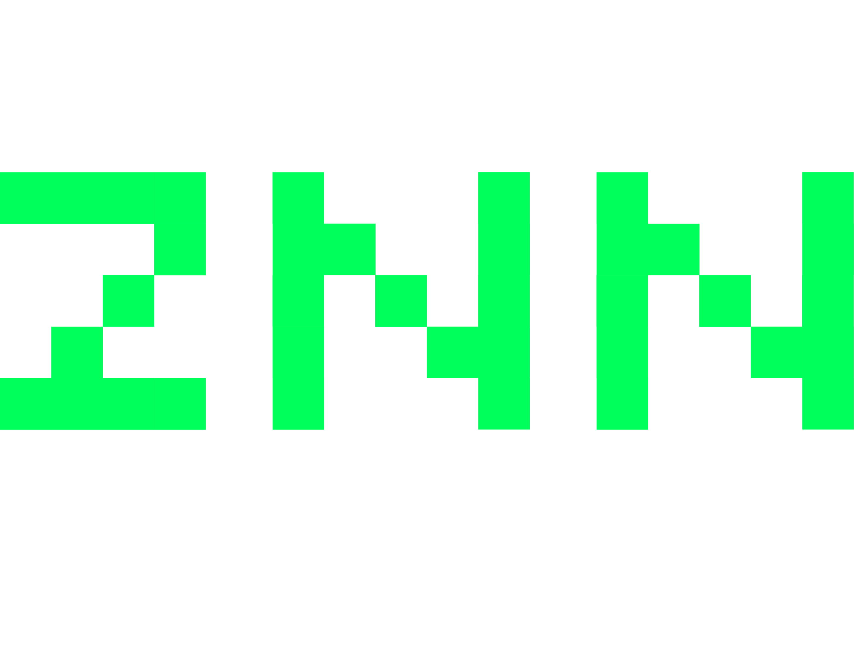

>bitcoin zenon quasar
Digital Gold
Tokenizes energy
Energy constrained value
Proof of Work Layer 1
Deflationary
Mining capacity is based on energy technology & physics
Right to mint is limited by mining hardware
Tender for deflationary goods
Digital Gold Notes
Tokenizes right to mint
Socially assigned value
Smart Contract Layer 1 + 2
Disinflationary
Minting capacity is based on good governance
Right to mint is limited by cyclical delegator assignment
Tender for inflationary goods
Feeless Digital Transactions
Tokenizes TX throughput
Network usage derived value
“Free gas”
Disinflationary
Minting capacity is based on opportunity costs
Right to mint is limited by network security contributions
Tender for network usage

Slide 8
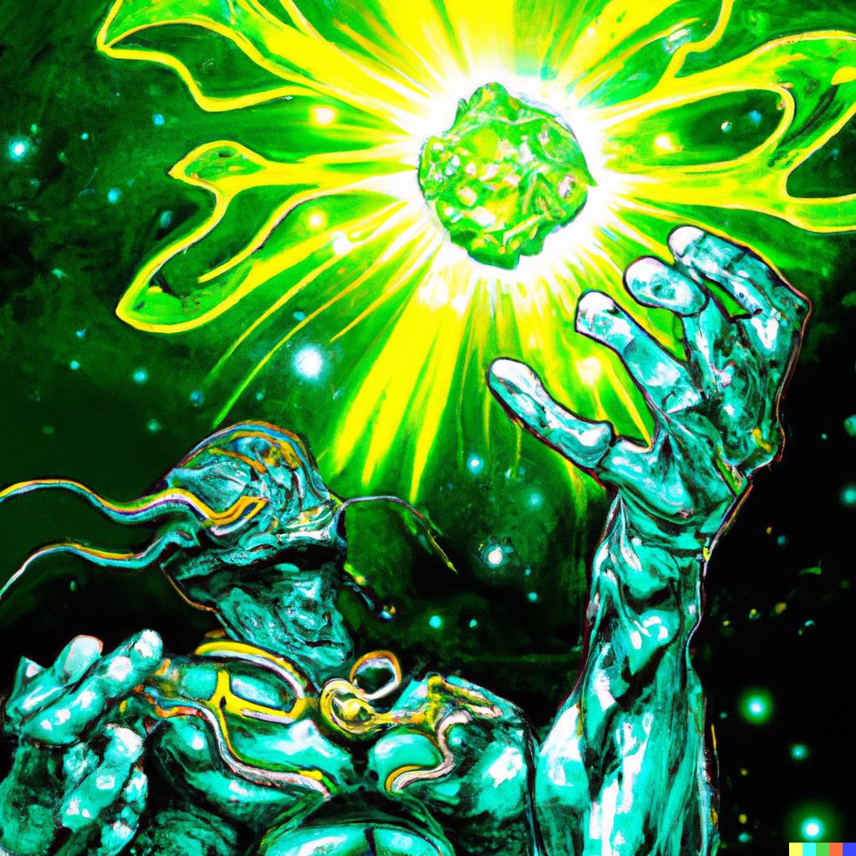
>dual coin economy - znn
ZENON
NoM’s main currency.
Needed to run network consensus infrastructure and participate in protocol emissions.
Secures the network through lock-up by Pillars, Sentinels, and Stakers.
Used by delegators to assign voting power to Pillars and influence their ability to produce Momentums and earn Momentum rewards.
Notes:
Increasing complexity & number of transactions increases the amount of Plasma / fused QSR
Plasma never gets spent and can be unfused back to QSR

Slide 9

>dual coin economy - qsr
QUASAR
A complementary disinflationary asset of NoM based on a mint & burn equilibrium that enables the feeless mechanism & is used to spawn Pillar or Sentinel nodes.
Tokenizes tx throughput & gives the NoM its feeless properties.
Is used for momentum production by fusing it to Plasma (as alternative to PoW).
Secures the network through burn or lockup by Pillars & Sentinels.
The majority of QSR was distributed to ZNN holders via lock drop based on a pre-Alphanet snapshot.

Slide 10
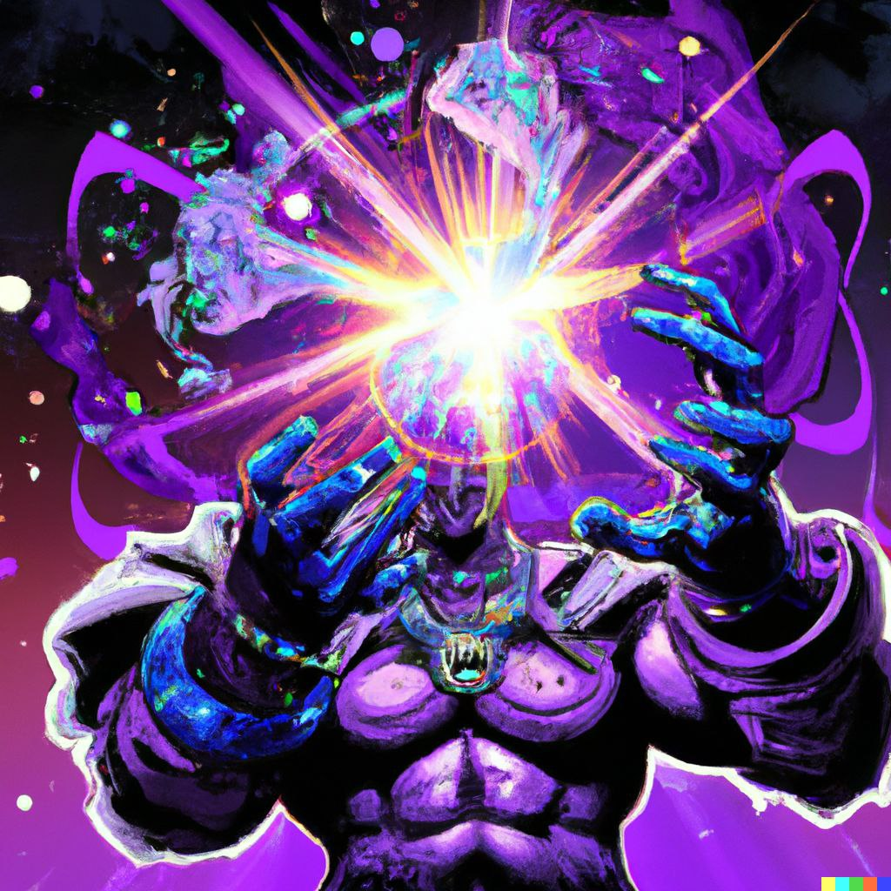
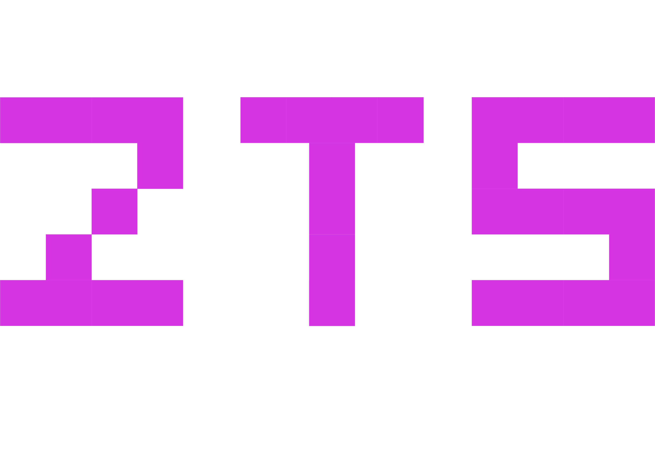
>dual coin economy - zts
ZENON TOKEN STANDARD
Programmable token standard for any asset on Zenon NoM.
ZNN and QSR are both ZTS.
Can have different properties, e.g.
fungible / non-fungible
burnable / mintable
utility / non-utility
Can be created in SYRIUS, the open source Zenon NoM wallet.
Can be used for tokenization and trustless, feeless transfer of any asset on NoM.

Slide 11


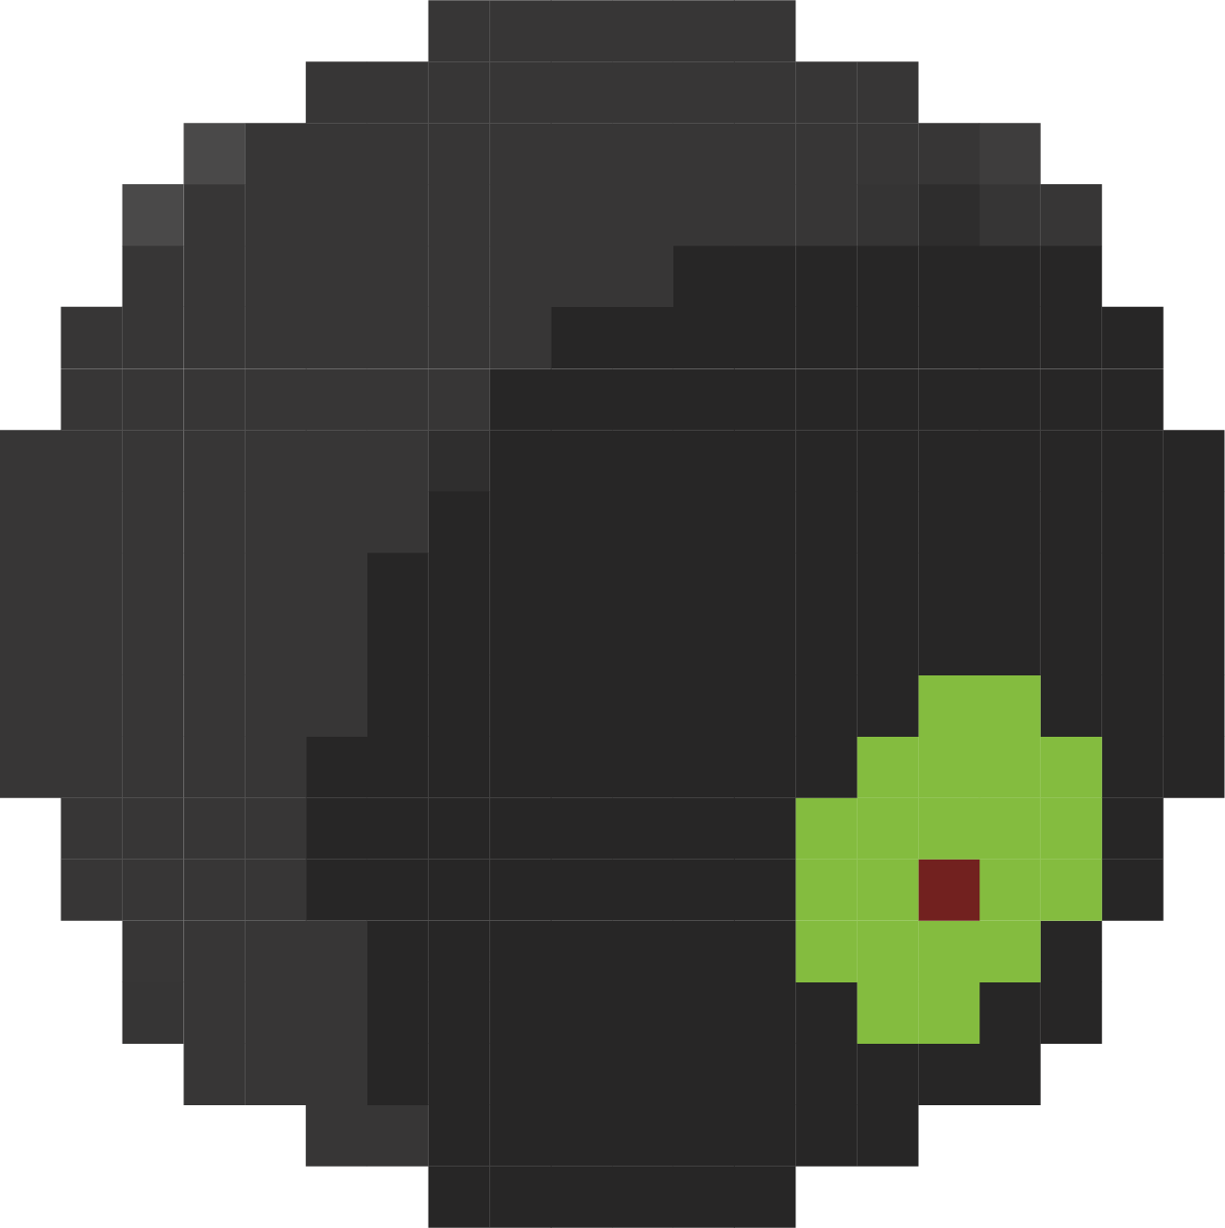
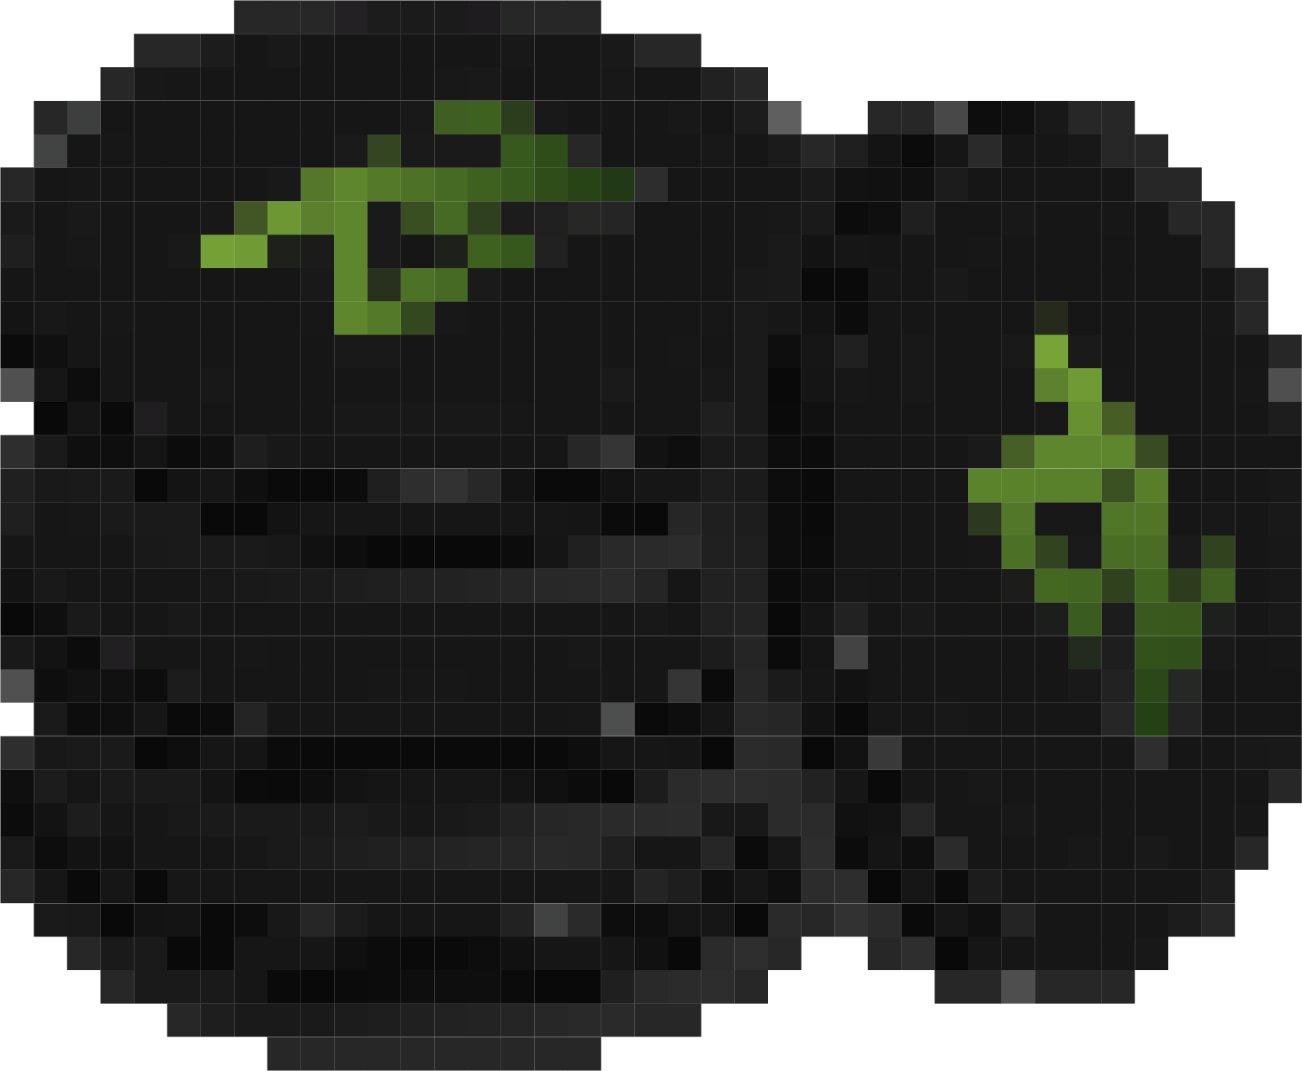


>network participants
Pillar
Consensus validators & momentum producers
Vote on accelerator grants & ZIPs
Require 15k ZNN + burn of linearly increasing QSR amount for every new Pillar. Now: 280k QSR
Delegator
Allocate ZNN to Pillars to increase their weight and ability to produce momentums
Receive a variable share of the Pillar’s momentum & delegation rewards in return
Sentinel (to be implemented in Phase 1)
Maintain the state of the dual-ledger and add PoW-links for transaction finality, preventing double spends & chain splits
Scale the network to up to 100k TPS and form a public backbone of full nodes
Require 5’000 ZNN + 50’000 QSR
Liquidity Provider
Provide on-chain liquidity for cross-chain DEX trading
Help secure the network by locking up ZNN in liquidity pools
Earn trading fees and protocol emissions (Orbital rewards) to off-set IL risks
Staker
Secure the network by locking up ZNN to generate QSR
The longer the lockup period, the higher the QSR reward multiplier
Sentry (to be implemented in Phase 1)
Protocol-level oracle (e.g. for trustless, programmatic cross-chain bridges)
lightweight node that stores only the block-lattice data structure

Slide 12




Plasma
>plasma, the feeless fuel
fuels feeless transactions on NoM. Plasma is created by PoW or by fusing QSR. For now, the PoW is done by the user’s device. More fused QSR = more plasma. When you make a tx plasma gets locked up. When the tx gets confirmed, you get the plasma back and you can unfuse it back to QSR. Both, tx send and receive requires plasma. Unlike gas, plasma is never spent. The amount of plasma needed varies with tx complexity. Plasma makes Zenon NoM fee- and spam-less.
How does plasma work?
Assume you fuse enough QSR for 100 plasma & make 2 txs each using 40 plasma. The account has 20 plasma left.
A pillar sees your 2 unconfirmed txs and gets elected to produce a momentum.
Until the transactions are confirmed by a momentum, 80 plasma are locked up and 20 plasma are available to use.
If the pillar confirms 1 tx, you get the 40 plasma back and now have 60 plasma.
If it confirms both txs, you get the 40 back from both txs and are back to the original 100.

Slide 13
Zenon incentivizes progressive decentralization through
>breaking the oligarchy of PoS networks
Egalitarian xStakes Genesis
The creation of the initial validator set was not skewed by unfair advantages.
The initial validator set could not coordinate to collude the system and break network security through double spends or chain splits.
The degree of decentralisation of the initial validator set was determined by nothing but the free market.
Dual-Coin Architecture ZNN | QSR
QSR is rewarded to those securing the network by adding PoW (Sentinels), locking up funds (Staking), ensuring price stability (Liquidity). Since QSR enables feeless transactions, people who secure the network get more tx throughput.
QSR also serves as collateral for network infrastructure. It must be burned in increasing amounts by those who want to govern (Pillars) and locked by Sentinels. People who secure the network get to run infrastructure.
The problem with most PoS networks is that the validator set never really decentralizes. People who run them can just keep spinning up validators at zero additional cost. This causes the voting share per validator to remain constant, even if the number of validators increases.
Zenon breaks this self-perpetuating oligarchy of single-token Proof-of-Stake networks by decoupling validator rewards and governance. By requiring a QSR burn for more pillars, but only rewarding pillars with ZNN, it means Pillars cant maintain the same voting share without adding additional network security in exchange for more QSR. Pillars have to choose between maximizing ZNN rewards through delegation, or acquiring QSR to run more Pillars. ZNN provides native yield, while QSR doesn’t.

Slide 14


“I think when there is an unfair playing field, people don’t want to build on it. You’d feel like someone else is benefitting from your efforts more than you.
This is why Zenon’s xStakes and progressive decentralization are so important.”
Prof. G

Slide 15
>znn genesis distribution & xStakes 1/2
xStakes: BTC Bonding & Refund Algorithm
Almost all ZNN was “gifted” via a BTC<>ZNN bonding algorithm (“xStakes”) at the Genesis Distribution.
Participants received 5k ZNN per 1 BTC.
Running a validator node for 1.5 years resulted in a full refund of the bonded BTC via monthly repayments.
The Network Stability Fund to bootstrap the network was fully distributed to validators.
The Zenon Fabric Fund consisted of locked ZNN that did not generate any rewards. They are now used to fund Accelerator Z, the Orbital Program and Vested Pillars.

Slide 16
>znn genesis distribution & xStakes 2/2
100%
Egalitarian
Distribution
To ensure the initial validator set was purely formed and naturally decentralized by nothing but the free market, the ZNN genesis distribution
... had no pre-sale / VC / insider / team allocations
... was publicly announced on Bitcointalk & Twitter
... was not advertised beyond word-of-mouth
... was fully anonymous
... did not give any special conditions to anyone
... refunded all BTC to committed validators
... did not limit how much ZNN anyone could acquire

Slide 17

“As an experienced real estate developer, the foundation matters a lot to me.”
0x3639

Slide 18
= reference to a hash
= signed message
>dual ledger consensus
assigned: Pillar A
assigned: Pillar B
assigned: Pillar C
assigned: Pillar D
Momentum Meta-Ledger
321
322
323
latest momentum = “The Frontier”
missed momentum
Epoch ≈ 1 day
Election cycle: every 5 minutes 30 unique Pillars are chosen using delegation based virtual vote to assign the producers of the next 30 momentums
Momentum assigned for every 10 seconds
All account blocks “acknowledge” a momentum (and thus a specific fork)
momentums confirm account blocks
Account Block-Lattice
Account X
1
2
3
Each account has its own chain and block height.
All transactions are account blocks.
Each account block is either a send or a receive.
A send specifies the receiver, the token, and the amount.
A receive references the hash of the send blocks.
Transactions are not automatically received, the receiver must create and sign the receiving tx (until then the tx remains “unreceived”).
first account block = “The Genesis”
Account Y
receive X #1
send X 5 ZNN
Account Z
receive X #3
Send Y 3 QSR
Visualization by @georgezgeorgez
Notes:
This next one isn’t something the devs ever hinted at.
There exists two value systems, energy constrained and assigned value. Bitcoin being deflationary and energy constrained, making it fair currency for energy constrained value. Zenon being (dis)inflationary where the right to print is assigned, making it a fair currency for assigned value. So Zenon is not only just a utility/scaling network, but can be a native currency for assigned value which is what most of the internet is. (You’re a moron spending BTC on a digital good, but that doesn’t mean some tx/value exchange shouldn’t occur). Supply/(energy constrained) markets will have the terms set by sellers who can demand BTC. While demand(assigned value) markets, will have the terms set by consumers who can demand to spend a fair but weaker currency.

Slide 19
Zenon NoM provides Smart Contract functionality on the protocol level.
>embedded smart contracts
Embedded Smart Contracts
VM Runtime Smart Contracts
VS
Are included in the node software itself
Can directly access any object/data the node has
Are directly upgradable via sporks
Existing embedded SCs on NoM:
>Accelerator Z (votes / payouts)
>Sentinel, Staking, Delegator, Liquidity Rewards
Future applications could be
>Protocol-level Liquidity Pools / AMMs
>NFT functionalities
>...
Are loaded onto a virtual machine
Offers an isolated interface to scoped ledger data
Are immutable and must be replaced to make changes
Read more on Big Inches Club House

Slide 20
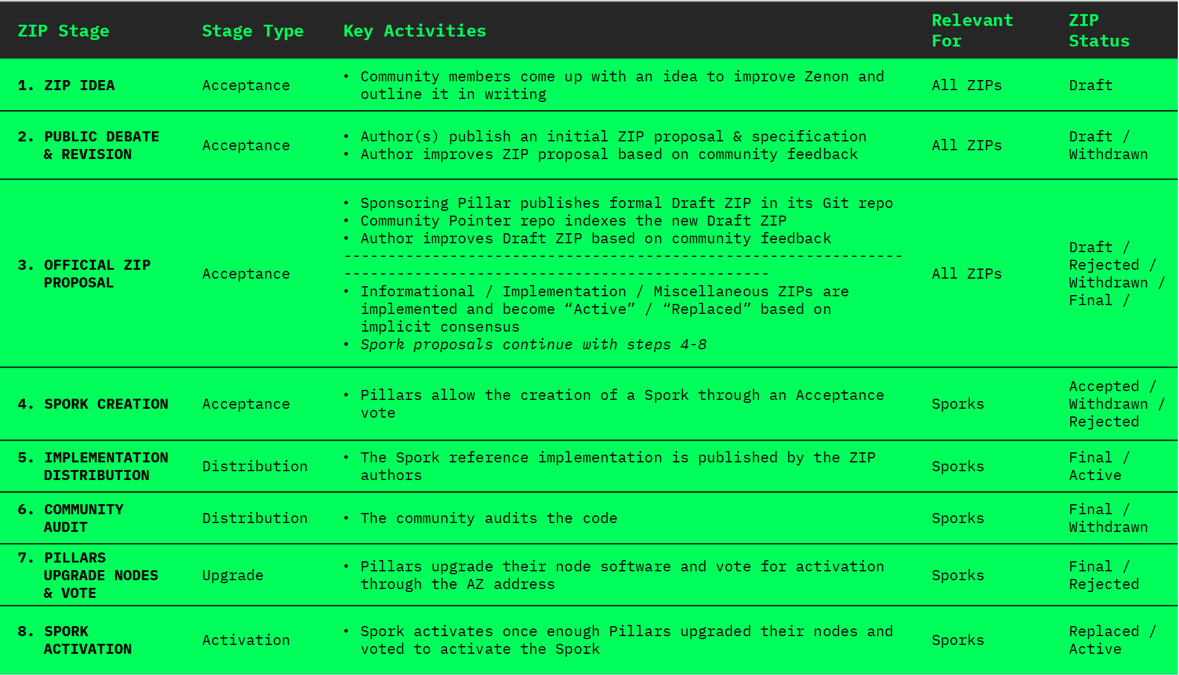
Inspired by the BIP process, just more decentralized.
>ZIPs - zenon improvement proposals

Slide 21
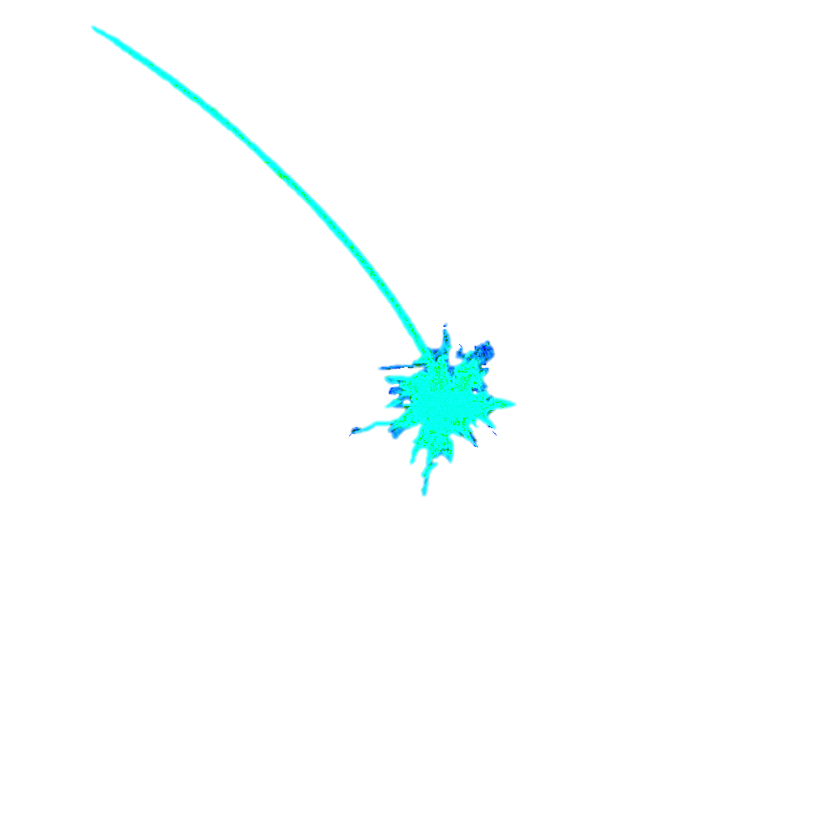
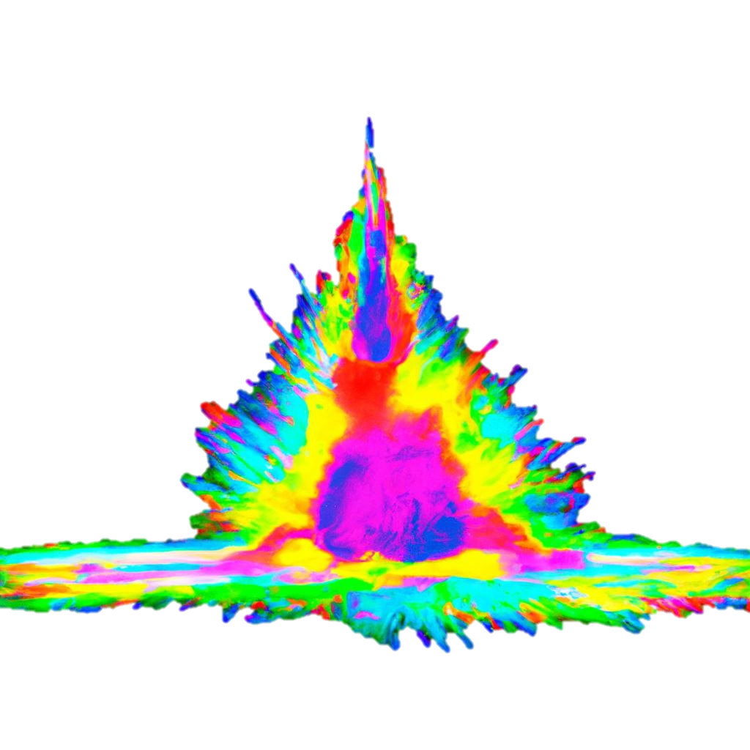

>roadmap and milestones
Final Alphanet Swap Decay Cycle
Incentivized Testnet
Zenon Network Phase 1 launch
wZNN <> wBNB BSC Bridge
Zenon Big Bang Alphanet Genesis (Phase 0)
QSR Lock Drop Snapshots
WarpDrive Hackathon
Genesis of Zenon Legacy Network
Bitcoin Taproot Activation
Mobile & Browser Wallet
Trustless Cross-Chain Bridges
New NFT Standard
Bitcoin Merge Mining
Feeless, Trustless zBTC
DEX / CEX Trading
zApps
...
XStakes Completion
Accelerator Z Spork Activation
Decentralized Sovereign Network States & Companies

Slide 22
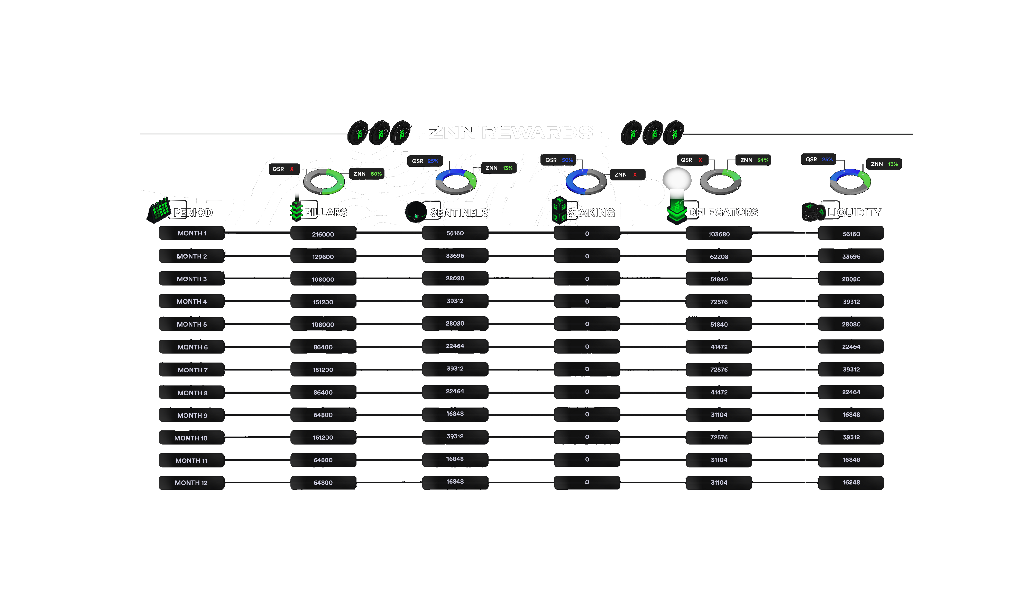
>alphanet emissions

Slide 23
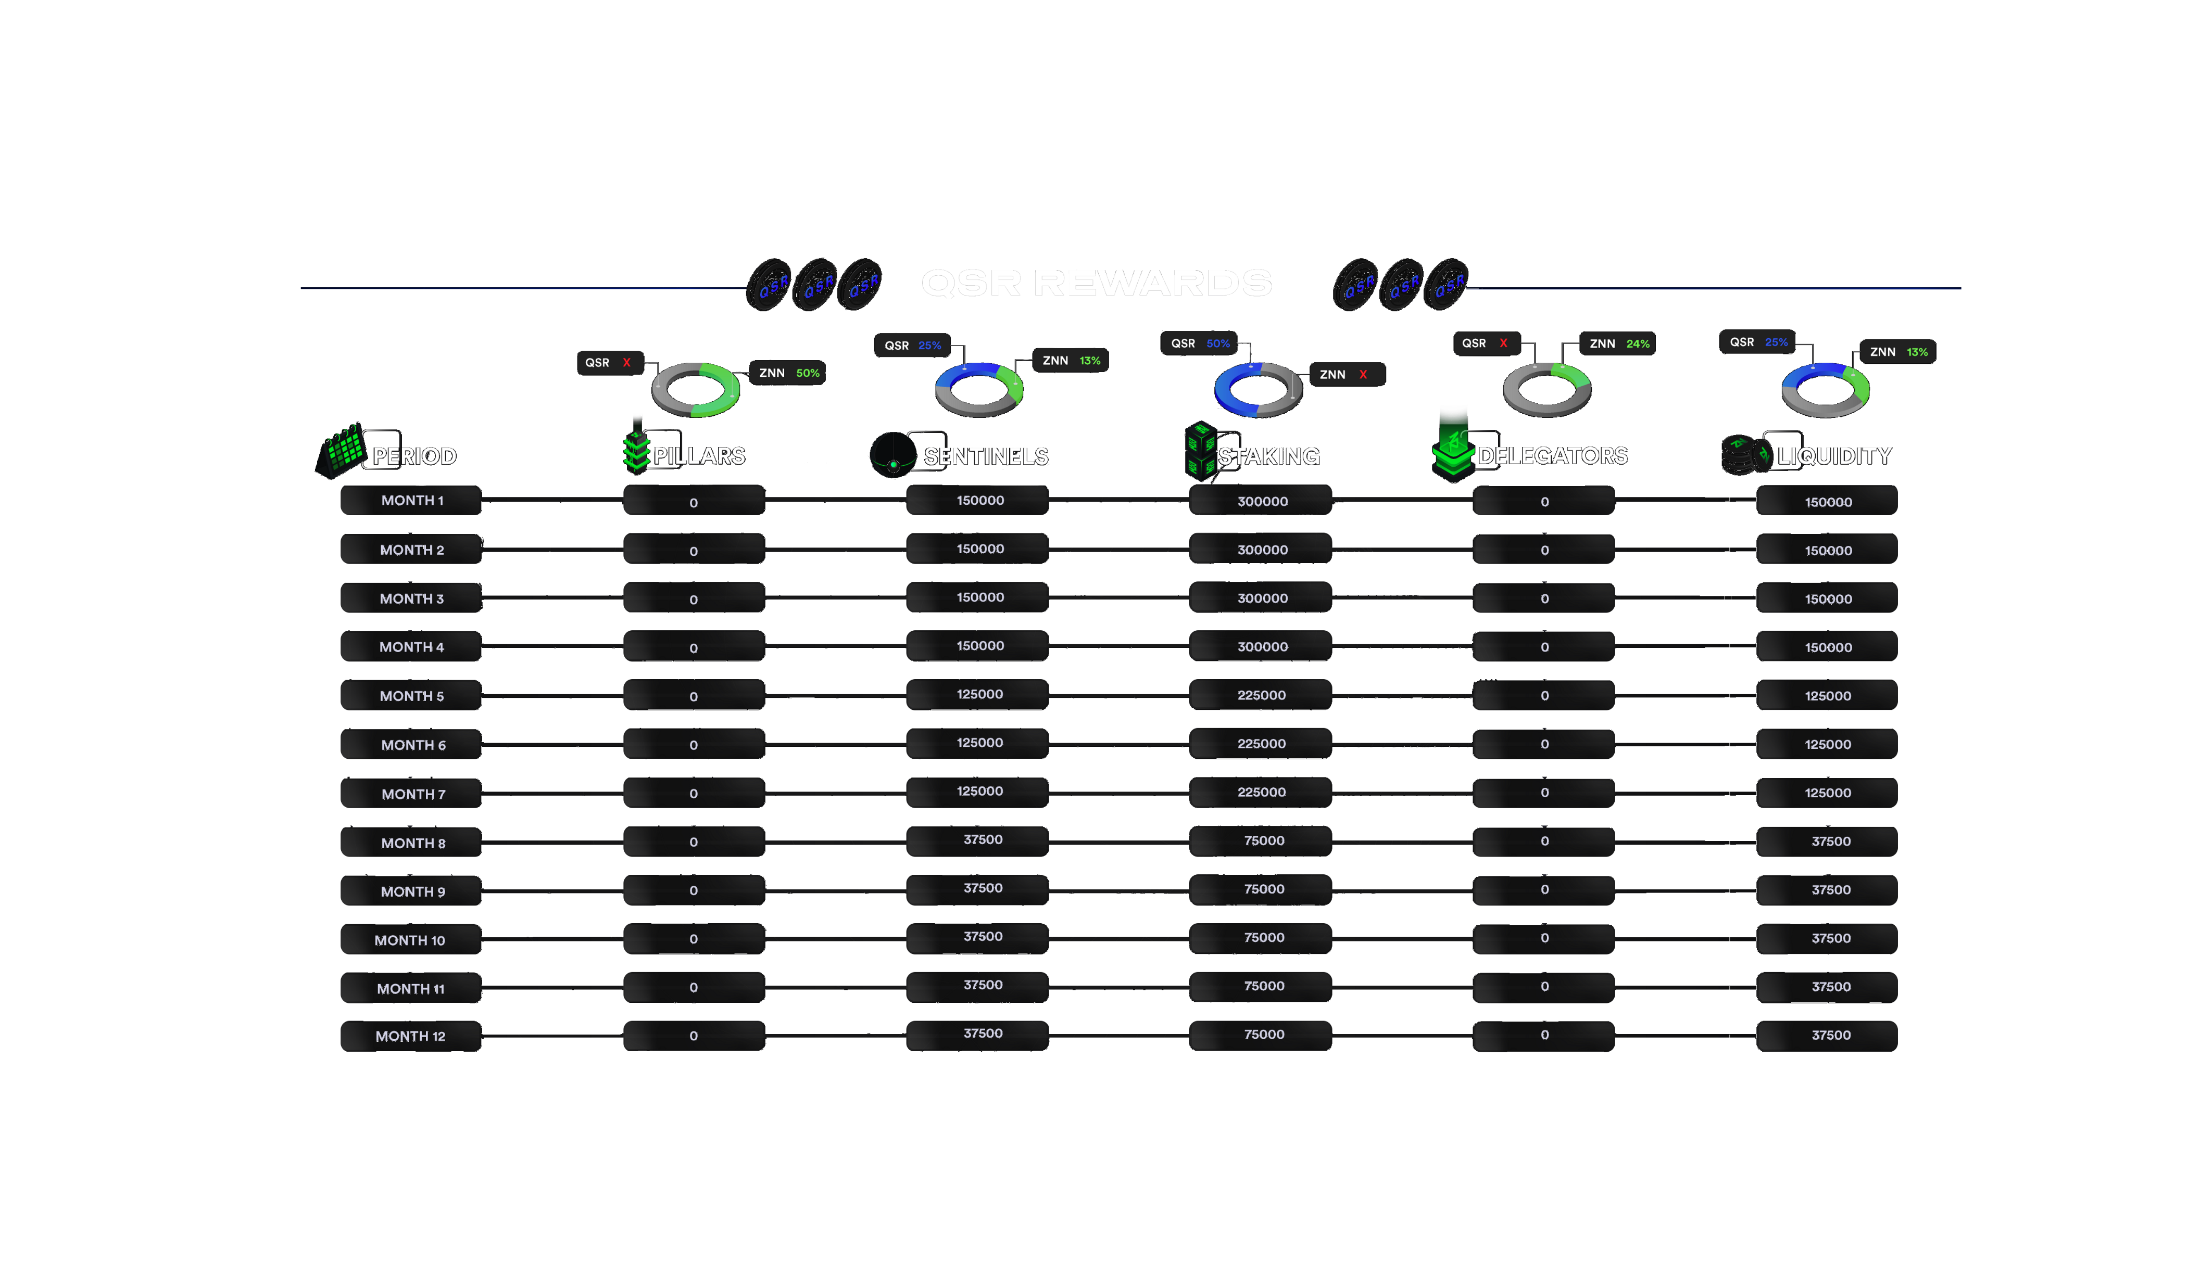
>alphanet emissions

Slide 24
>znn & qsr alphanet supply
emissions after epoch 12 are tbd / assumed to remain constant
ZNN Supply | 6.51m | 6.77m | 6.98m | 7.29m | 7.50m | 7.67m | 7.98m | 8.15m | 8.28m | 8.58m | 8.71m | 8.84m
ZNN Emissions | 432k | 259k | 216k | 302k | 216k | 173k | 302k | 173k | 130k | 302k | 130k | 130k
QSR Supply | 25.34m | 25.94m | 26.54m | 27.14m | 27.59m | 28.04m | 28.49m | 28.64m | 28.79m | 28.94m | 29.09m | 29.24m
QSR Emissions | 600k | 600k | 600k | 600k | 450k | 450k | 450k | 150k | 150k | 150k | 150k | 150k
Pillar Burns | 5.83m | 1.28m | 1.05m | 840k | 550k | 410k | 270k | 0 | 0 | 0 | 550k

Slide 25

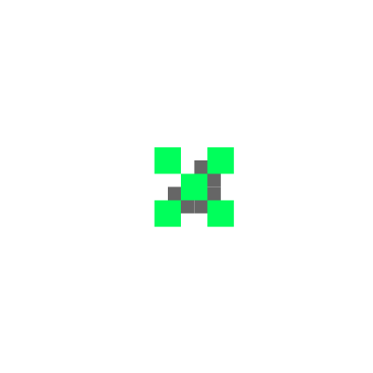
“Only a moron would spend BTC on a digital good.
But that doesn’t mean that tx/value exchange shouldn’t occur.”
Prof. G

Slide 26
>digital gold notes
ENERGY CONSTRAINED VALUE
SOCIALLY ASSIGNED VALUE
Miner ability to convert energy to BTC is constrained by physics
Value exchange in the digital economy rarely requires BTC to change hands
Improving efficiency to harness energy creates exponential future growth. It makes sense to get paid for it in something that gets more valuable over time (= BTC)
BTC is the deflationary commodity based on deflationary energy technology
BTC = fair currency for energy constrained value
Pillar ability to print ZNN is assigned by delegators who believe in good governance
All value exchange in the digital economy is almost entirely about assigned value
Digital consumer goods (entertainment, art, services) create time-limited value. It doesn’t make sense to pay for them in BTC which grows in value over time
ZNN is the disinflationary tender for cyclically assigned value based on trust, belief & faith
ZNN = fair currency for socially assigned value
BTC = DIGITAL GOLD
ZNN = DIGITAL GOLD NOTES
Notes:
There exists two value systems, energy constrained and assigned value. Bitcoin being deflationary and energy constrained, making it fair currency for energy constrained value. Zenon being (dis)inflationary where the right to print is assigned, making it a fair currency for assigned value. So Zenon is not only just a utility/scaling network, but can be a native currency for assigned value which is what most of the internet is. (You’re a moron spending BTC on a digital good, but that doesn’t mean some tx/value exchange shouldn’t occur). Supply/(energy constrained) markets will have the terms set by sellers who can demand BTC. While demand(assigned value) markets, will have the terms set by consumers who can demand to spend a fair but weaker currency.

Slide 27



>bitcoin pow recycling
In NoM Phase 1, Sentinels are introduced. They are full nodes which create PoW links and strengthen the requirements for a tx to be valid by adding weight. This prevents chain splits and helps break ties if there is a double spend.
Multiple sentinels would add a PoW link to a tx and the tx would only be valid if it has enough PoW links.
When Sentinels are added, txs will likely not be sent directly to pillars. Instead, Sentinels will broadcast the PoW link and all nodes will update the frontier of account chains.
This way, Sentinels can provide a deterministic ordering mechanism.
In addition to using Bitcoin’s PoW for tx finality on NoM, recycling of Bitcoin PoW for merge mining of BTC and plasma for feeless transactions on NoM is also expected to be possible.
Zenon NoM
Bitcoin PoW
Momentums
PoW Links
Bitcoin Blocks
Bitcoin Miners
Notes:
POW Links
with the right incentives will force sentinels to consolidate and quickly orphan forks
in theory you have pow links be on momentums/already confirmed tx but I think if you do pow links on unconfirmed tx and require a certain number of pow links, you create a deciding factor between two conflicting account blocks
deeZNNutz (0)(0), [06.09.2022 20:45]
but if the network forks, 2/3 and 1/3, doesn't the 1/3 fork still produce momentums? And sentinals on the 1/3 fork would create POW links for that smaller network?
George, [06.09.2022 20:47]
Yes it will still produce momentums
And it is up to the users to determine which fork is “legitimate” by acknowledging those momentums
Sentinels will likely see more txs/weight is happening on one fork and consolidate there. That’s the incentive that needs to be built
I think it will be required for all tx to have pow links on it
So even if momentums are producing, if no sentinels are there, tx may not be able to be confirmed
George, [06.09.2022 20:19]
One of the main criticisms against PoS is the “nothing at stake” argument where validators can and may have incentives to build on top of forks because it’s costless
We will have sentinels creating PoW links, there is something at stake
They can’t just create pow links for tx on any possible fork out of thin air
So the questions is how to incentivize sentinels to stay on the same fork (with the most hash power/weight)
George, [06.09.2022 20:24]
Sentinels paid by pow-links on txs that get confirmed?
Creating Pow-links which adds weight to prevent double spends. Also stated by Mr Kaine to act as the public backbone of the network to prevent network split
Adding a pow-link requirement could be sentinels sending the pow link, which gets stored with the tx in our mempool equivalent.
Pillars can then only include tx with enough pow links in momentums. They still know about the other tx though.
I think when sentinels are added, we will not use the models of tx sent directly to pillars.
I think sentinels will broadcast the pow-link to all and all nodes will update the frontier of account chains.
The sentinels may help provide a deterministic ordering mechanism.

Slide 28
>layered scaling with trustless, feeless sidechains
Zenon Network has been designed from the ground up to support layered scaling with trustless, feeless sidechains (L3) on top of NoM (L1/L2) on top of Bitcoin (L1).
The key to layered scaling are interoperable, nested side-chains which keep use case specific on-chain data off the main chain and only use the latter for consensus disputes.
Thanks to Zenon’s egalitarian launch and progressive decentralization incentives, using Bitcoin’s PoW as ultimate layer of adjudication for consensus disputes creates a highly scalable, trustless DLT structure that makes the blockchain trilemma redundant.
Nested Sidechains for feeless, trustless zApps powered by Plasma & NoM
DACs (Funds, REITs, Trusts)
L3
Zenon NoM
PoW/PoS
Gaming Assets
Tokenized TradFi Assets
zBTC
Sentries act as protocol-level oracles between NoM mainchain, sidechains, and off-chain data
P2P Lending & Borrowing
Bitcoin PoW
ZK Proof Digital ID
P2P Trading & Money Markets
Sentinels do PoW links on sidechain txs to validate consensus
L1/L2
Pillars validate mainchain consensus
L1

Slide 29


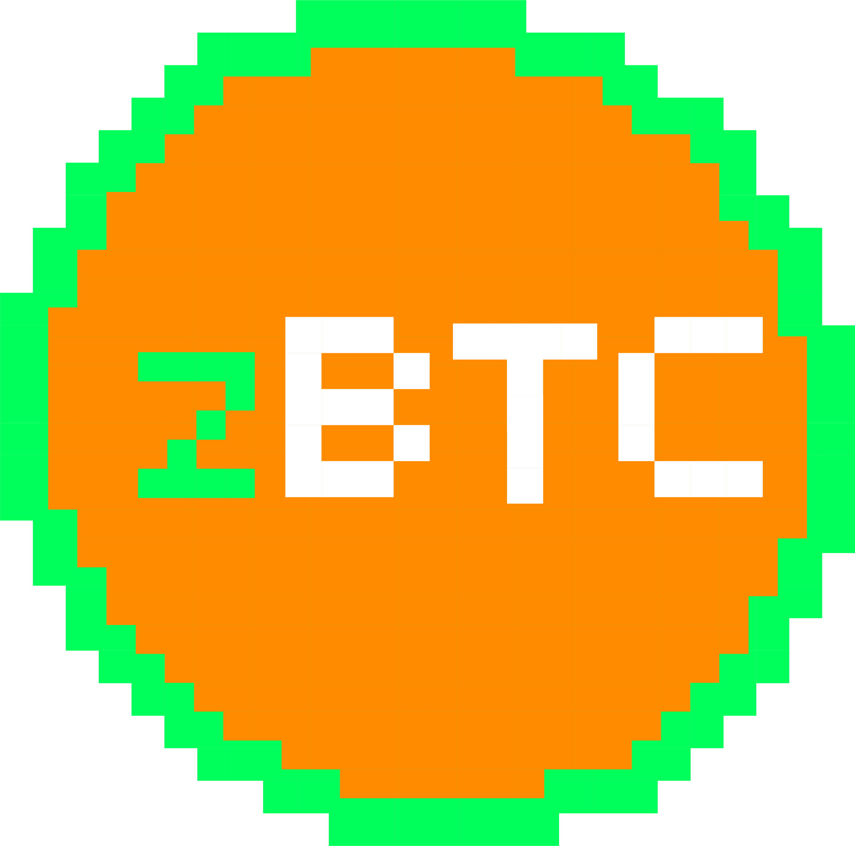
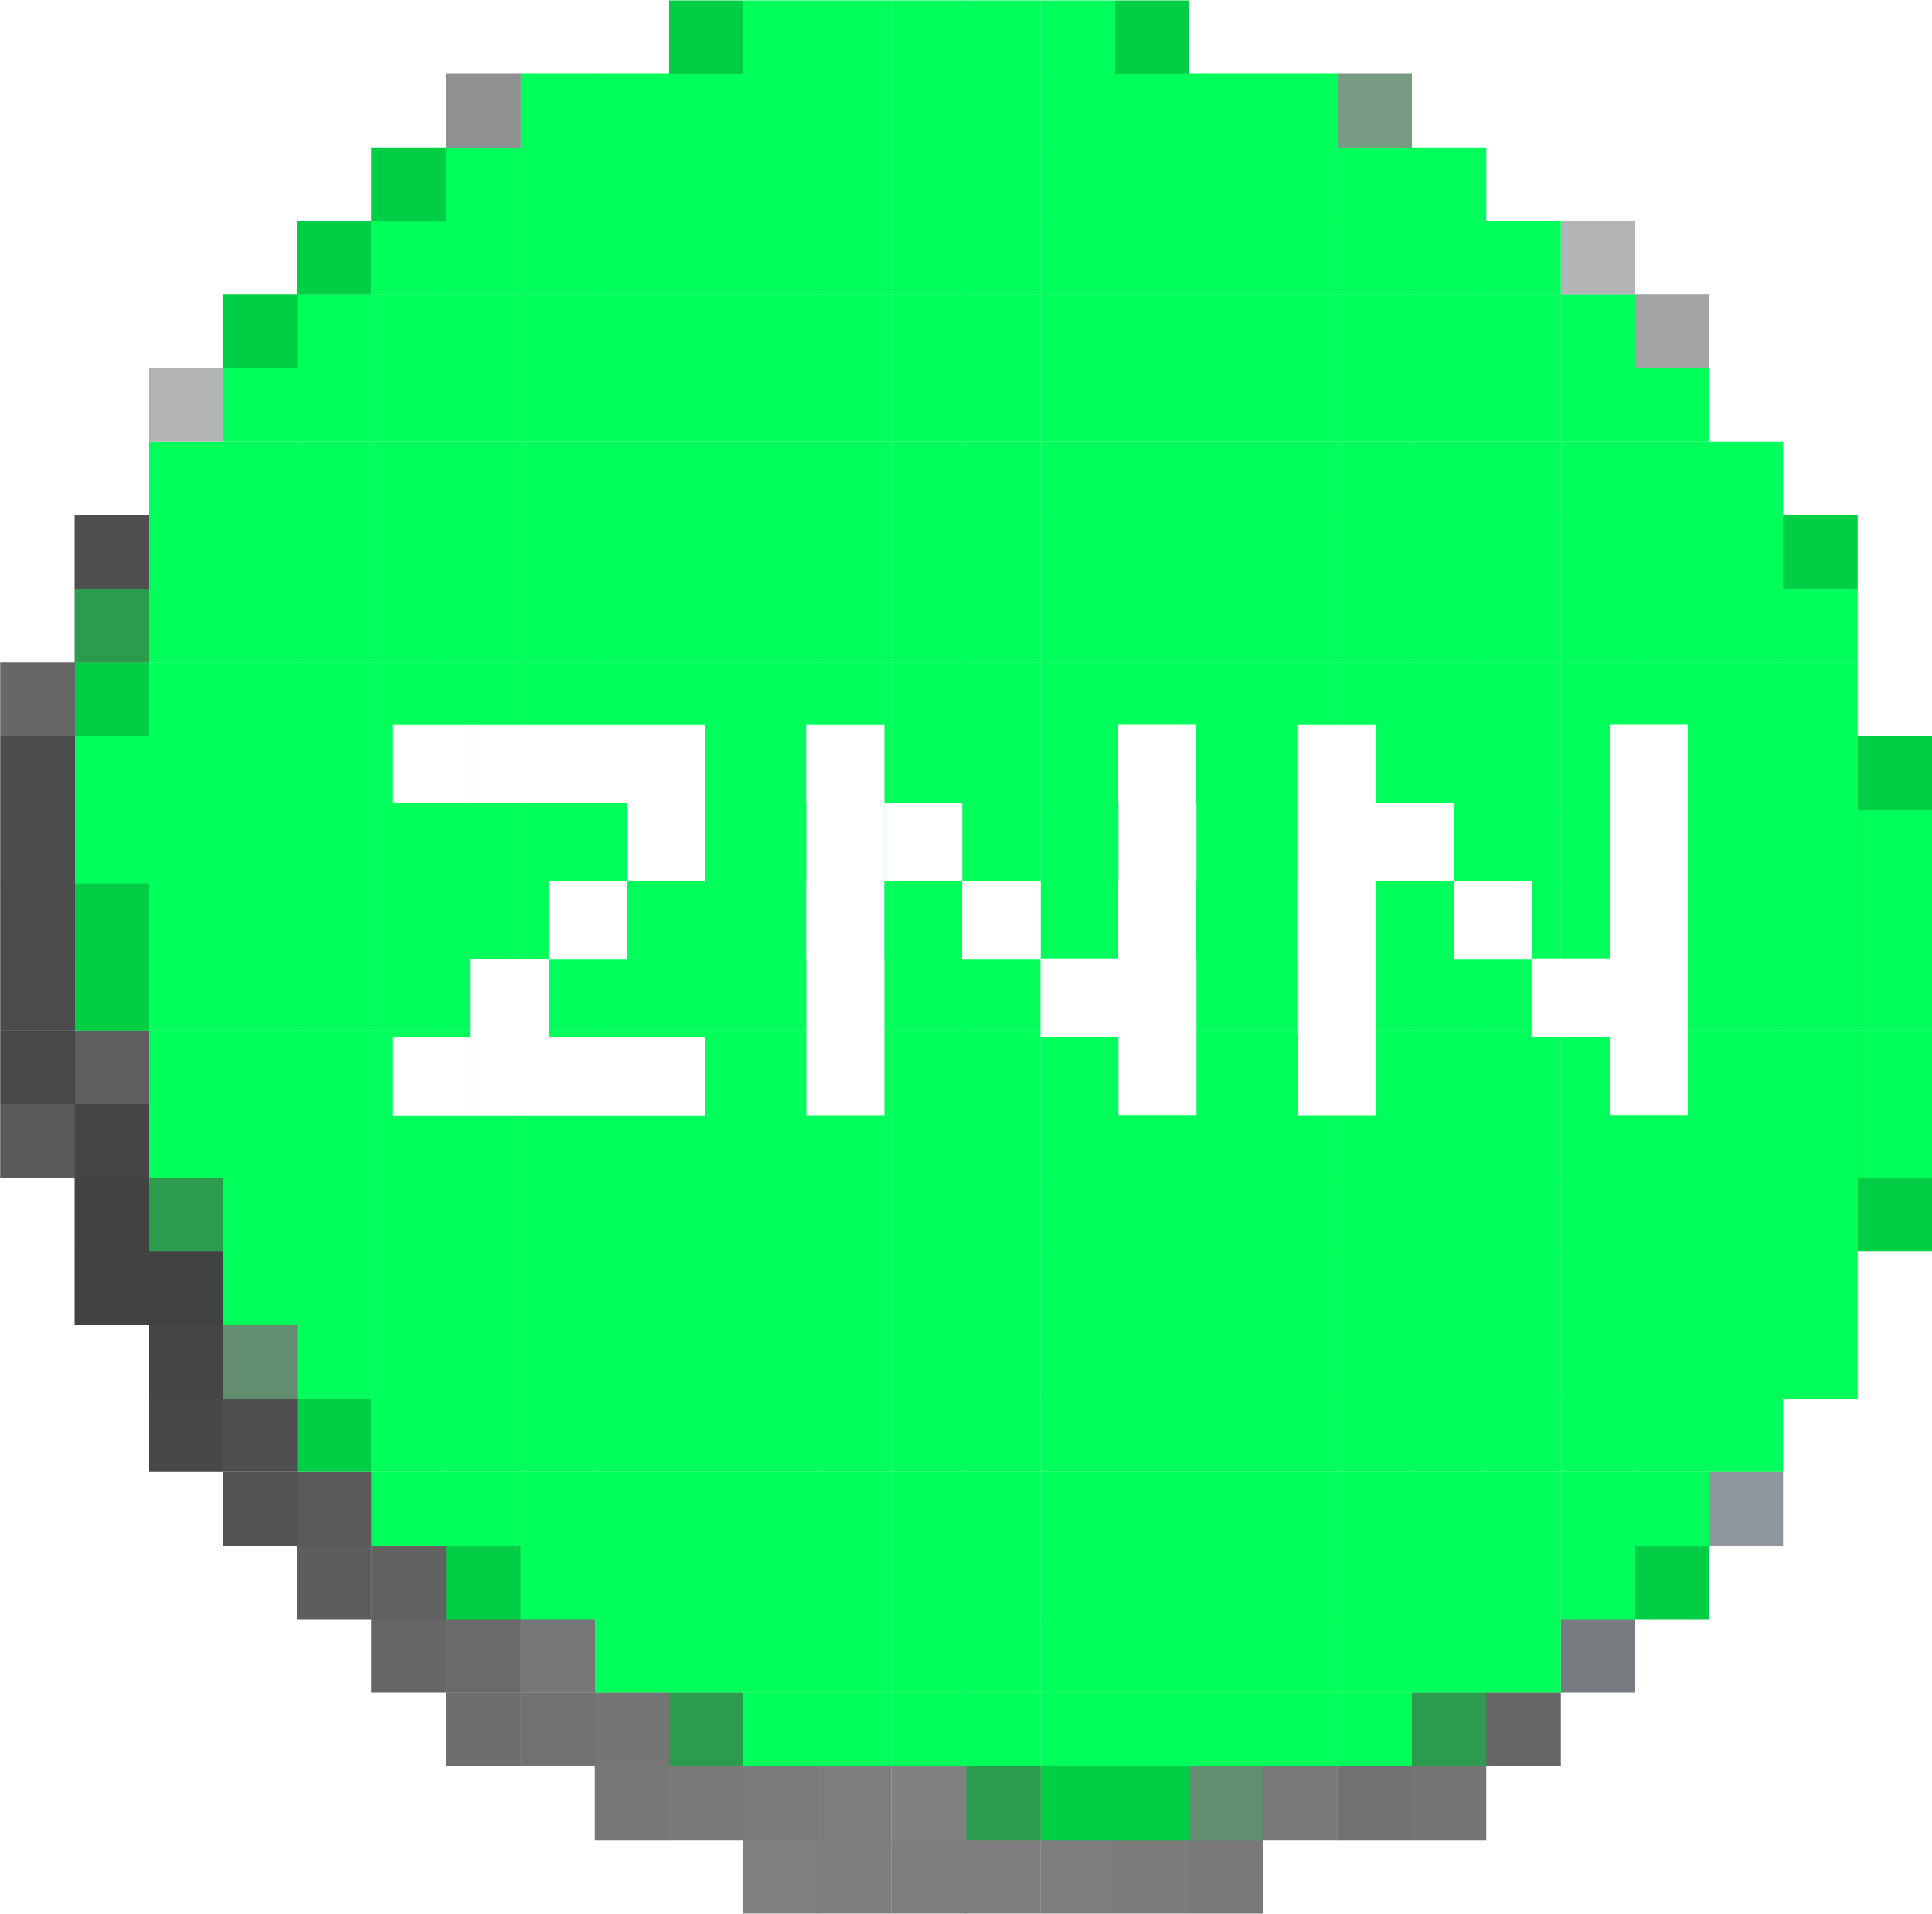
>zBTC - trustless, feeless, instant, privacy-enhancing
BTC Taproot enabled massive multisig, meaning that BTC can be custodied by all Zenon Pillars in a Threshold Signature Scheme (TSS). This allows the creation of overcollateralized zBTC that is as decentralized as NoM itself while bearing all properties of a Zenon Token Standard (ZTS) token:
BTC<>zBTC Bridge
The bridge is necessary to convert BTC to zBTC and back, while the zBTC/ZNN liquidity pool offers trading pairs for zBTC.
Both, the zBTC/ZNN liquidity pool as well as the BTC<>zBTC bridge can be secured by Pillars.
Bridging creates tx fees on the BTC main chain. To ensure there is always more BTC than zBTC, zBTC can be burned with some ZNN from Liquidity emissions or AMM trading fees (if any).
zBTC/ZNN Liquidity Pool AMM
BTC ZNN
Collateral Pool
Trustless
Feeless
Fungible
Privacy-enhancing
Near-instant (up to 100k TPS)
Whenever the signatory set of the BTC/ZNN Pillar TSS vault changes, the collateral must be moved to a new address. This creates tx fees for moving the BTC. To maintain (over-)collateralization of zBTC by BTC, ZNN from Liquidity emissions can be used to buy zBTC and burn it.
Notes:
For everyday usage of BTC as money, scaling solutions are needed. In the future most people will not use bitcoin at the base layer.
Currently the options are:
- Lightning which is great for specific purposes but not as a general scaling solution.
- Locking BTC up in a consortium multisig sidechain like Liquid. Centralized de jure. And with no usage despite being Blockstream’s lol.
- Locking up BTC in a VC controlled L1. Centralized de facto.
Zenon’s launch and progressive decentralization mechanisms will ensure that zBTC will be the most decentralized and secure. BTC Taproot enabled massive multisig meaning that the BTC can be custodied by all of the pillars
It will be as decentralized as NoM itself
For “BTC” on other chains
Including zBTC
Only the reserve is protected by Bitcoin’s security
The tokenized BTC is secured by that network’s validators
That’s why progressive decentralization of our validators is so important
3 Ways of Bitcoin interop:
Trustless 2 way peg between BTC and zBTC zts with threshold pillar multisig
BTC payment channels (not Lighting) using NoM as a judge when closing channels (logical 2 of 3 multisig. Where a threshold pillar multisig is the third logical signature)
These two can be generalized to NoM having some sort of control over certain btc utxos with certain conditions for spending that are not native to bitcoin. NoM serves as a smart contract runtime for BTC using data from BTC transactions. I think this would mean there would need to be a BTC Oracle layer for NoM to consume… Or more likely the case, every pillar also runs a bitcoin node.
3- NoM can serve as an Oracle for discreet log contracts on Bitcoin which are more private since they don’t need to go through NoM consensus
I think we may see things like cross chain swaps inside channels to mint zBTC
Maybe someone opens up a BTC Lightning channel with the entire Zenon Network and sends btc.
The pillars then mint zBTC and open up a payment channel with the user on Zenon and sends it.
Feeless zts token transactions and the sending through Zenon payment channels give us costless (except small inflation of course) and very private transactions because zts tokens are fungible (and so would be zBTC)
Maybe a portion of orbital can be used for the fees
Pillars buy zbtc and burn it. We will have the same issues for any zbtc construction. If the signatory set changes
One idea is using say 1% (important thing is the concept not number) of liquidity emissions to purchase zbtc from a liquidity pool which then gets burned
Or maybe when a new pillar joins, some of the QSR for the slot instead of getting burned, is used to buy zbtc to get burned
Basically how to ensure that the liabilities (zbtc) is less than or equal to the assets (BTC) since there are BTC tx fees, and the need to periodically move BTC?
Bitcoin doesn’t really have way to have trustless 2-way side chains.
So Zenon can again, provide its own L1 for trust/attention markets while also being THE layer that enables trustless zbtc sidechainsk
The 2 way part is important. I think spacechains can achieve it 1 way with merge mining
One criticism bitcoin maxis use against sidechains which rely on their own token for security is that people need to buy the token
Actually Zenon’s pow tx neutralizes this argument
ZNN will still have value though because again it is a fair currency for non energy-derived markets. And it can add additional utility through tokenization and public smart contracts, which likely will require Plasma as gas.
Fees for changes in signature scheme: Dedicate part of the emissions / liquidity rewards (ZNN/QSR) for fees to buy ZBTC from the zBTC LP pool and burn it to make sure zBTC is always (over-)collateralized

Slide 30
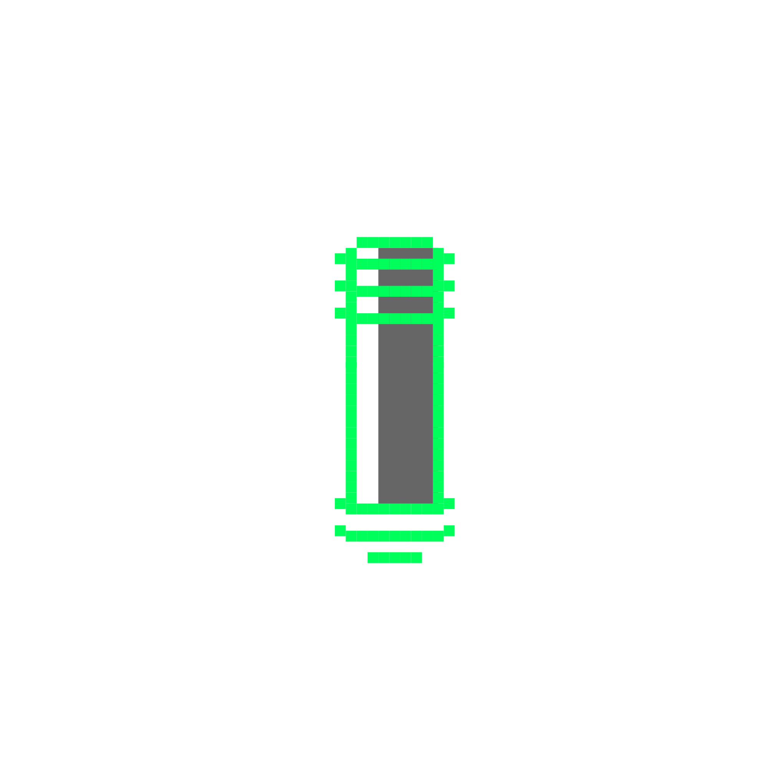

“Interoperability with Bitcoin can go beyond value transfer. Every detail must be taken into account.”
Mr. Kaine

Slide 31
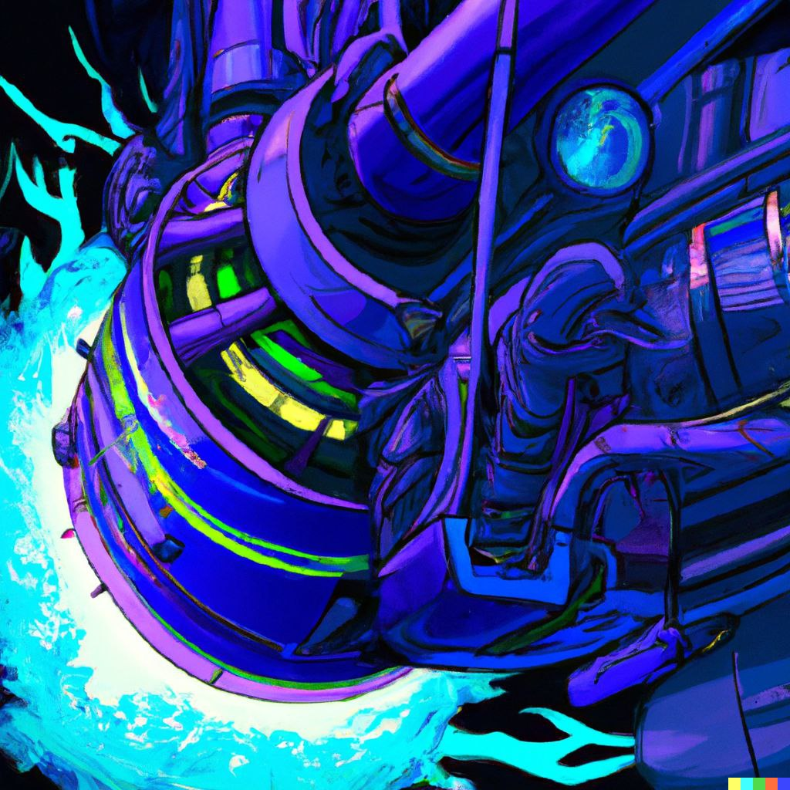

900k ZNN + 8.4m QSR in On-Chain Project Funding
>accelerator z
AZ is a decentralized, next-gen funding powerhouse for Web3 innovation - entirely governed by the Zenon community through the SYRIUS wallet.
Zenon Accelerator from A to Z
Get familiar with Zenon and Accelerator Z
Pick a network need or propose one
Study AZ application best practices
Introduce yourself to the community & Pillars
Write your proposal
Submit it on-chain and promote it
Get approved by Pillars
Build, deliver, get paid!

Slide 32
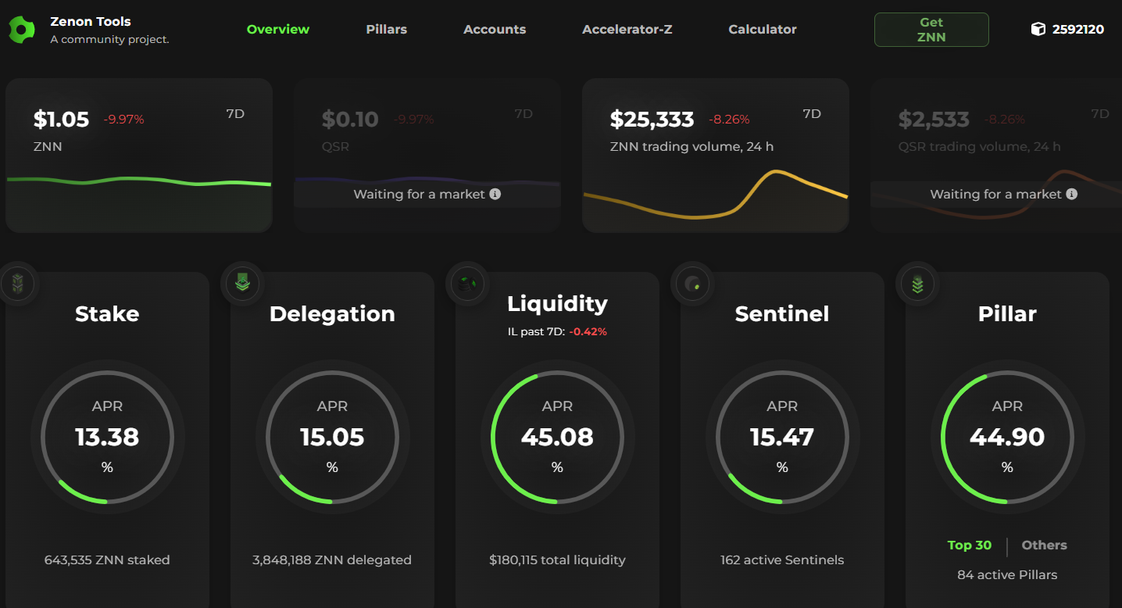
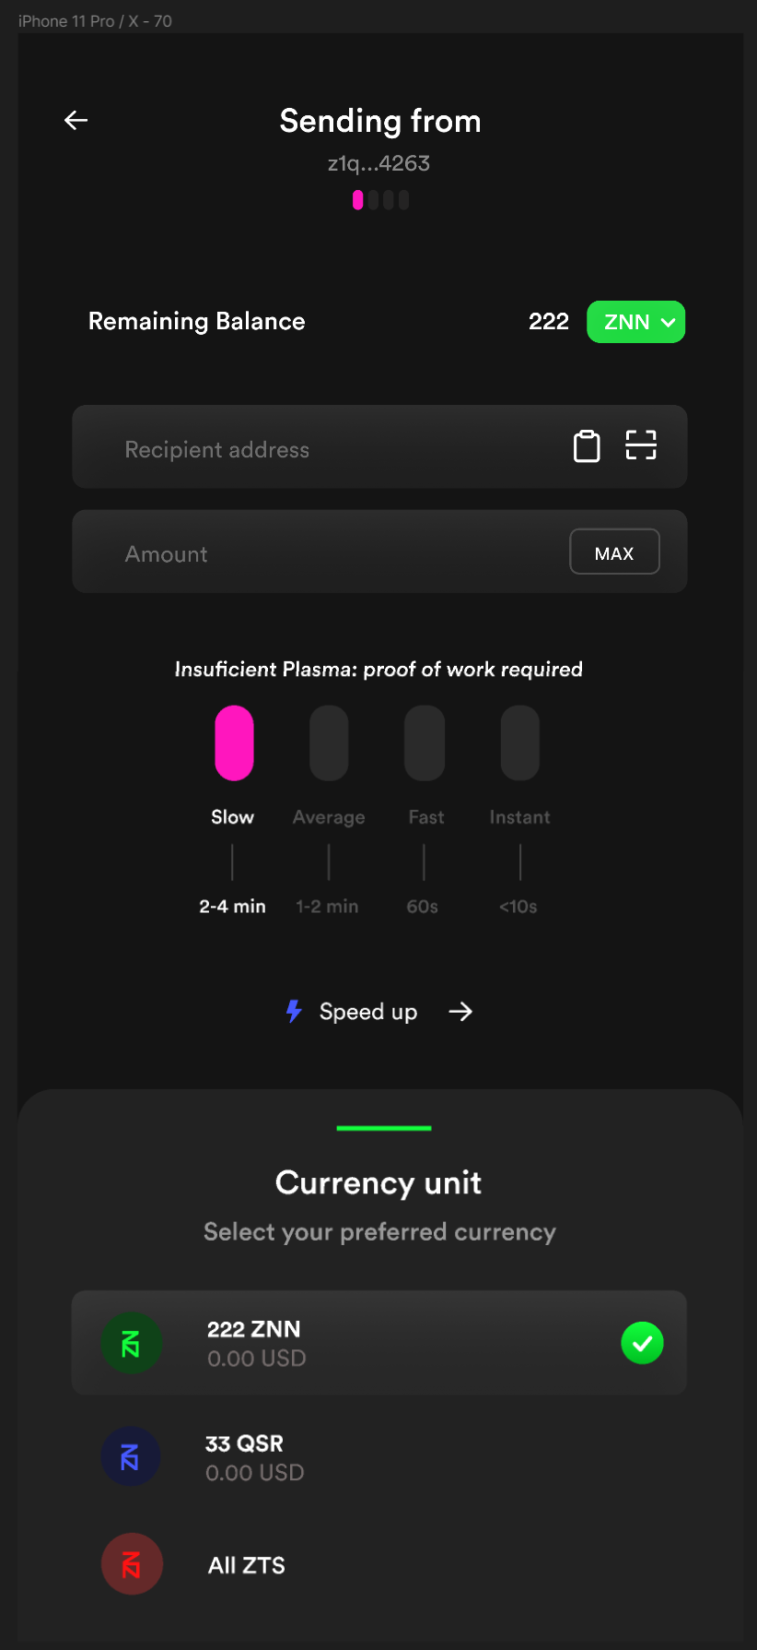
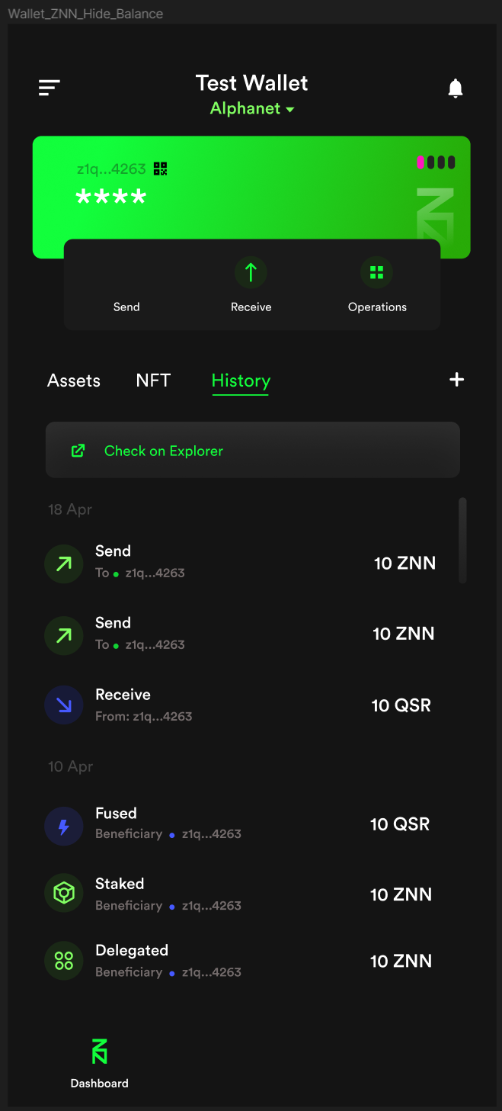
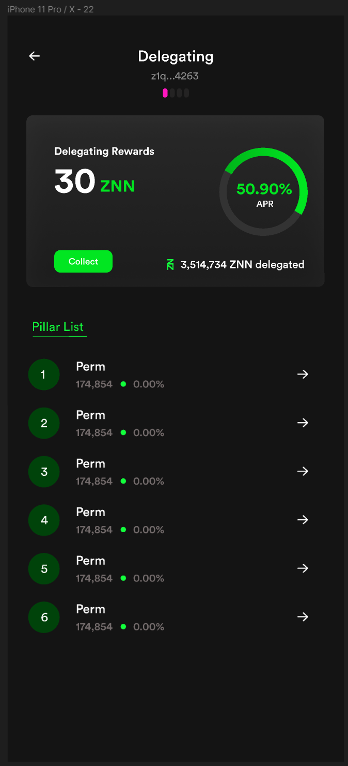
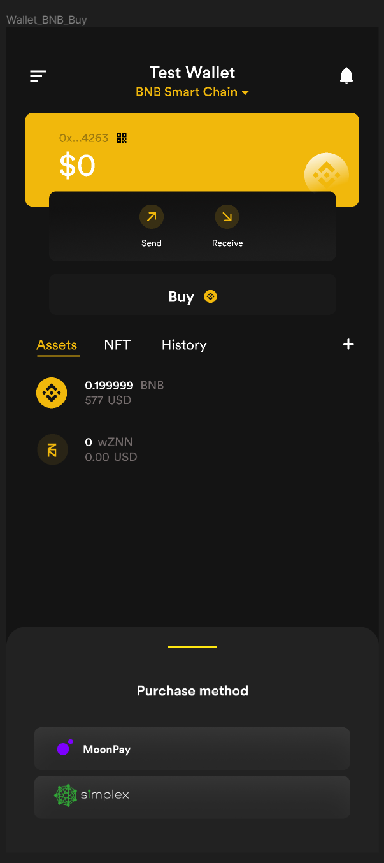
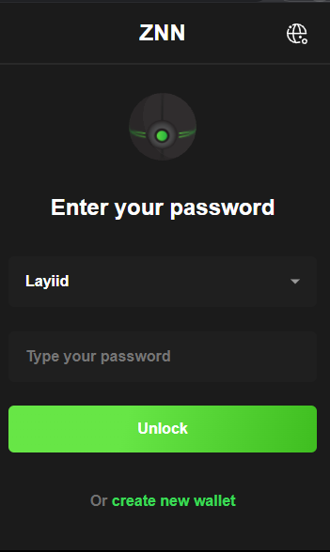
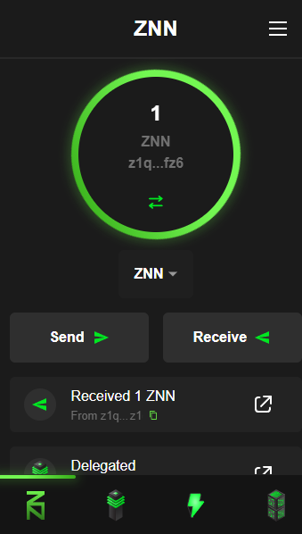
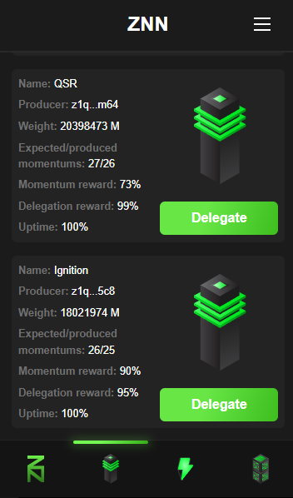
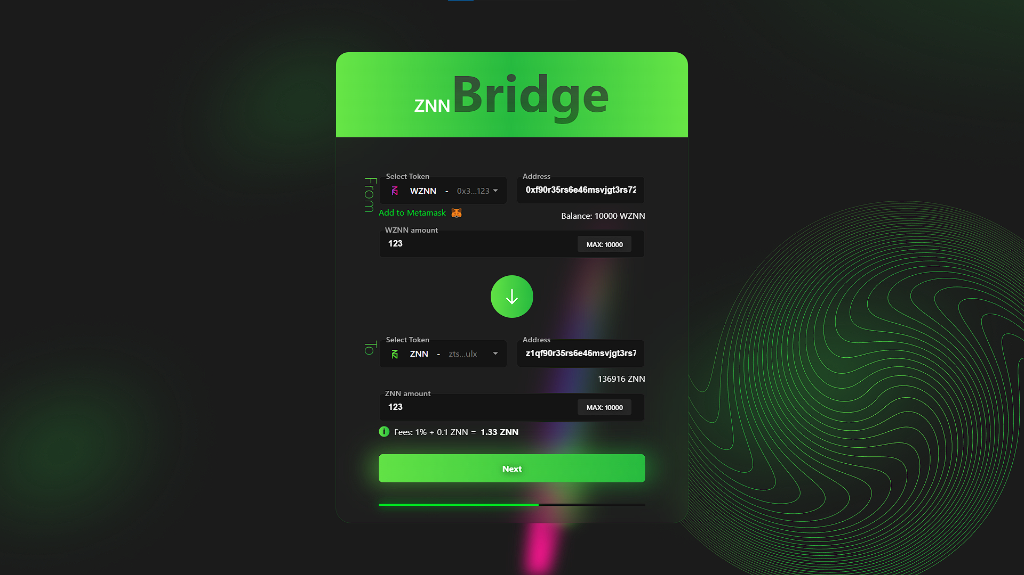
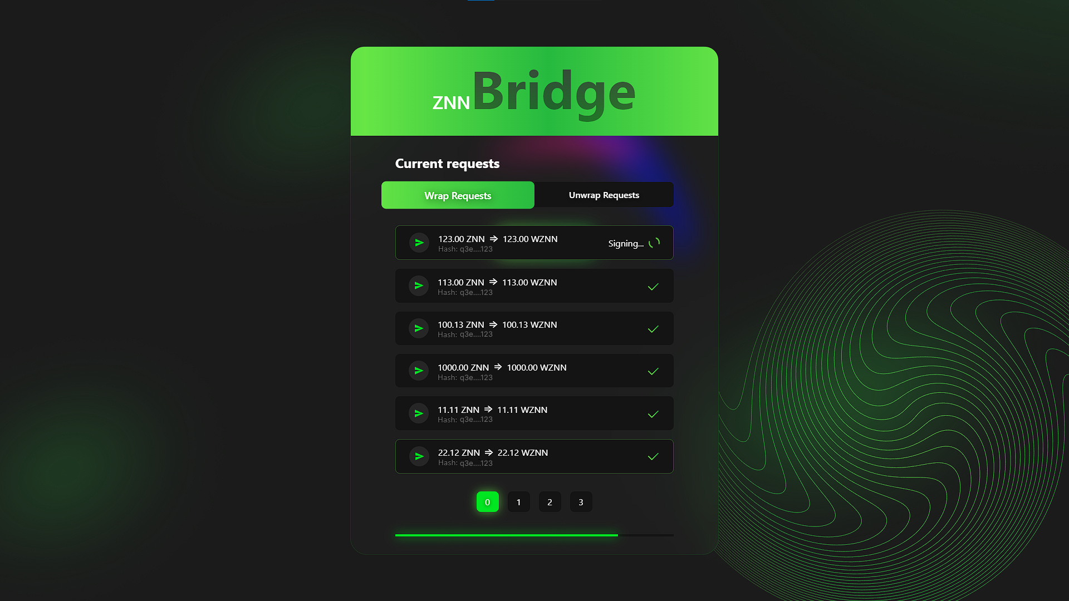

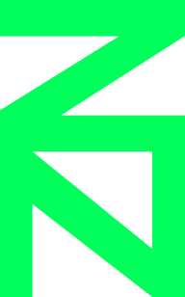
Zenon.Tools by @vilkris
>community funded projects
Mobile Wallet App by @DrBlaze21
Syrius Browser Extension by @dexZNNter
SDKs
JS/TS, Rust, Go, Java,
Kotlin, Python, C#
And many more…
Software Development Kits by various contributors
Cross-Chain Bridge Web App by @su_mamu

Slide 33
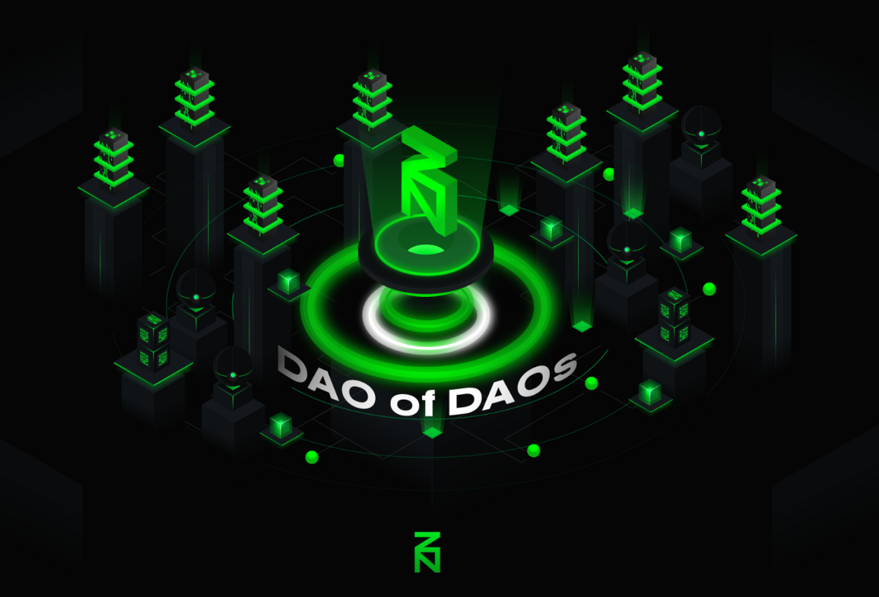
>to be funded
We are looking for builders to realize the following projects
>hardware wallet support
>smart contract runtime (zWASM)
>SDK ports (C/C++, Swift, Common Lisp)
>znnd optimizations (IBD, tx processing, light node)
>enhanced p2p layer using libp2p
>NFT standard implementation
>merge mining & BTC<>zBTC bridge
>unikernel integrations
>atomic swaps
>frame.sh
>DEX
>...
Join our builders

Slide 34

>FAQ
>How to get ZNN
>Buy wZNN and bridge it to ZNN
>OTC channel (beware of scammers)
>How to get QSR
>No secondary market exists yet, try OTC
>How to run network infra and earn yield
>Download the SYRIUS wallet and run a Pillar, Sentinel, Stake, Delegate, or LP on PCS
>How to apply for an AZ grant
>Follow these instructions
More questions?
Ask the community!

Slide 35
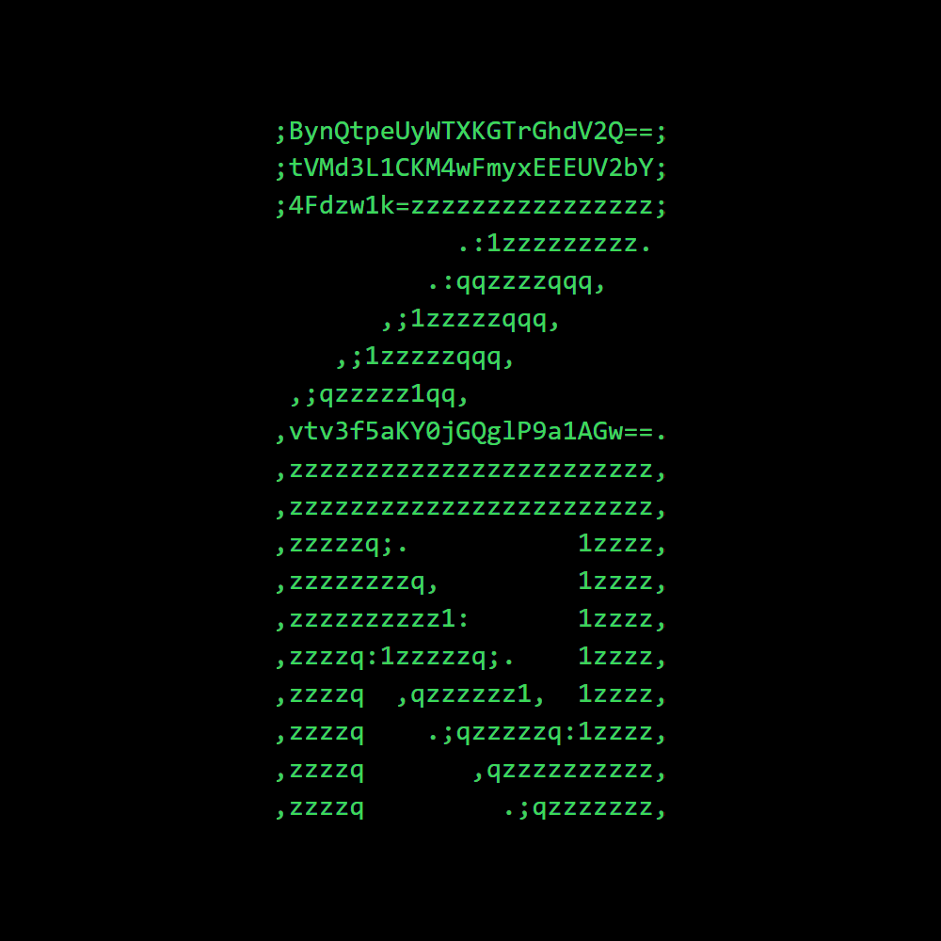
TAPROOT
₿LOCK 709632
“Never doubt you can make history. You already have.”
@zenon_network

Slide 36

My gratitude goes to Layiid, George, and 0x3639 for their support during the creation of this deck.
Extension & change requests: @shazzamazzash (Telegram).
Shazz

